Slide 1
Research Questions & Hypotheses
Is air quality monitoring for PM_{2.5} differential in American Indian (AI) communities and non-AI communities?
What are the differences in ambient PM_{2.5} concentrations in American Indian (AI) and non-AI communities?
Hypotheses: PM_{2.5} monitoring coverage will be lower, and PM2.5 concentrations will be higher, in American Indian communities compared to non-American Indian communities of comparable SES and population density.
Notes:
Hypotheses: PM_{2.5} monitoring coverage will be lower and PM2.5 concentrations will be higher in American Indian communities compared to non-American Indian communities of comparable SES and population density.
-descriptive study to form future hypothesis for research

Slide 2
Data Sources
US County and AI reservation shapefiles
US Census county-level sociodemographic characteristics
Population Density
Median Household Income
Annual PM_{2.5} Monitor Coverage & Concentrations, Model Estimates
EPA Air Quality System (AQS) Database
IMPROVE Rural Monitoring Network
Notes:
Note on reservation data source: American Indian tribal subdivisions are administrative subdivisions of federally recognized American Indian reservations/off-reservation trust lands or Oklahoma tribal statistical areas (OTSAs). These entities are internal units of self-government and/or administration that serve social, cultural, and/or economic purposes for the American Indian tribe or tribes on the reservations/off-reservation trust lands or OTSAs. The Census Bureau obtains the boundary and attribute information for tribal subdivisions on federally recognized American Indian reservations and off-reservation trust lands from federally recognized tribal governments through the Census Bureau's Boundary and Annexation Survey (BAS).

Slide 3
Classifying American Indian Counties
Defining American Indian (AI) Status: County defined if they meet one or more of the following criteria:
US Census: Counties >5% AI Population
Rural AI County Clusters [Wallace et al., 2019]
Counties within tribal subdivisions of federally-recognized reservations
Notes:
Strong heart study as a second bullet point; included partly because of individual-level health data in the SHS cohort for CV outcomes

Slide 4
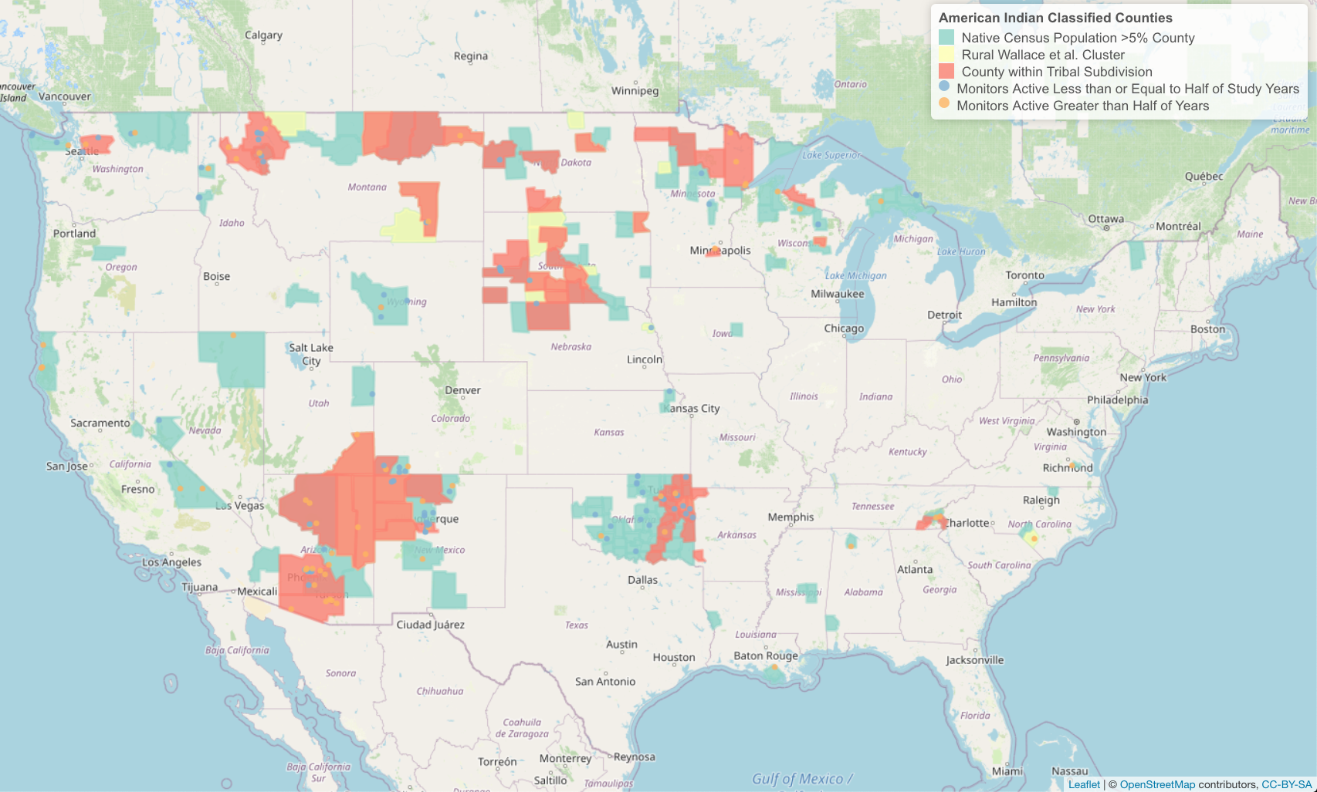
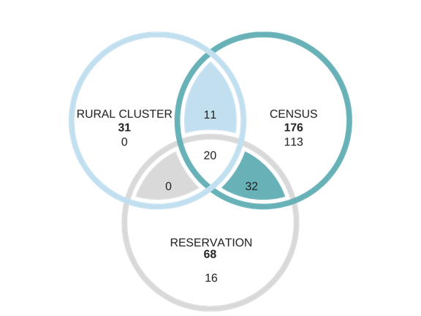

Slide 5
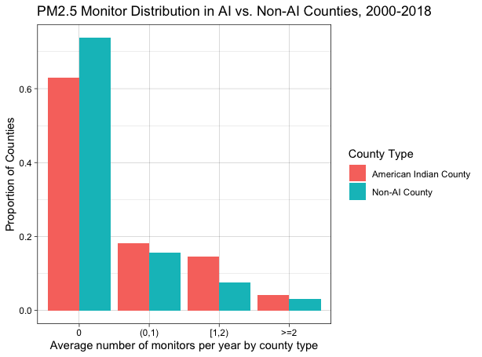

Slide 6
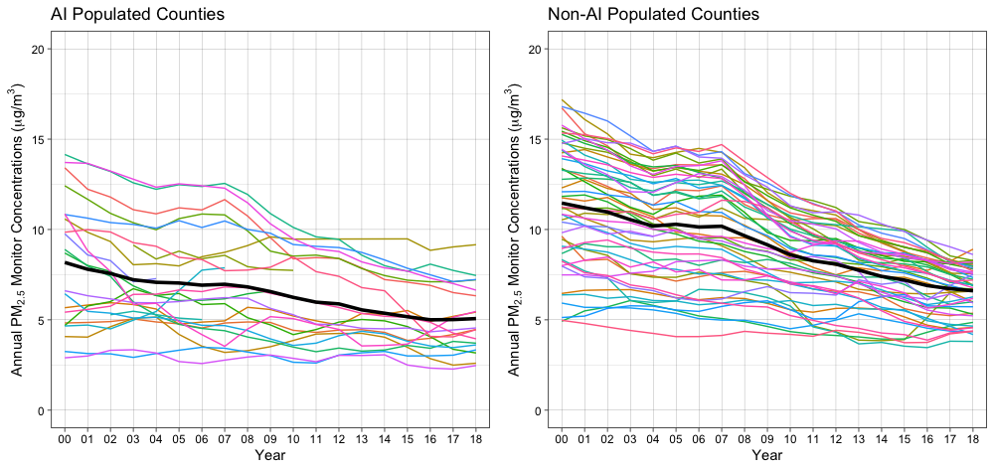
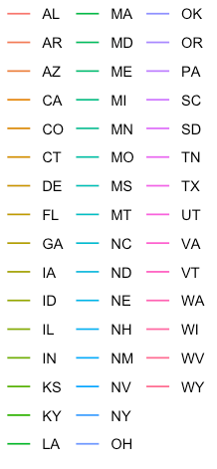
Monitor

Slide 7
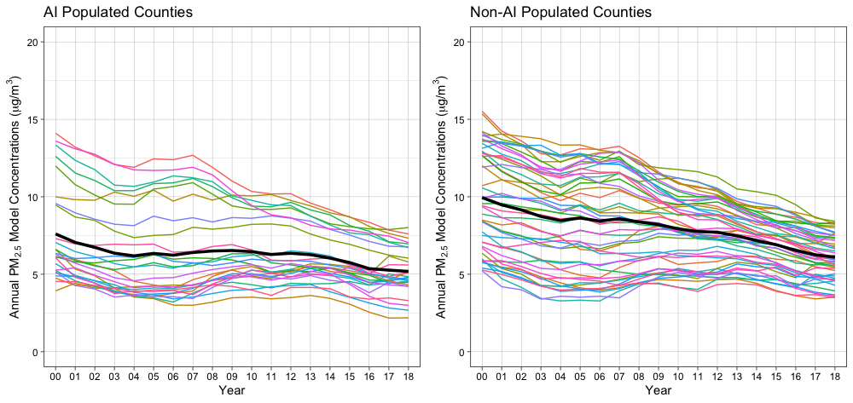
Model

Slide 8
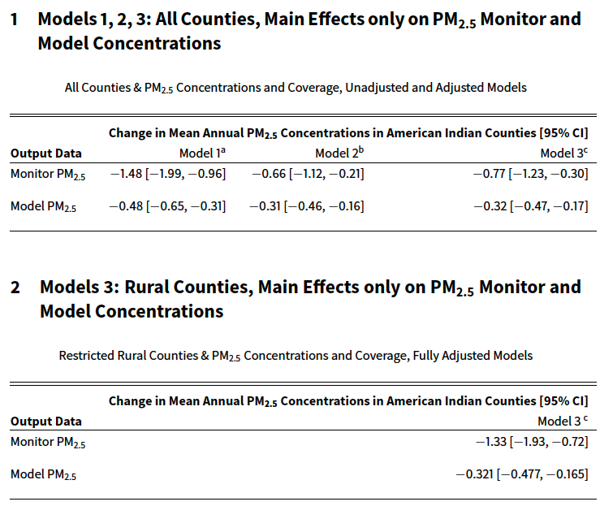
ªModel 1 adjusted for county type.
^{b}Model 2 adjusted for county type, population density.
^{c}Model 3 adjusted for county type, population density, median household income.

Slide 9
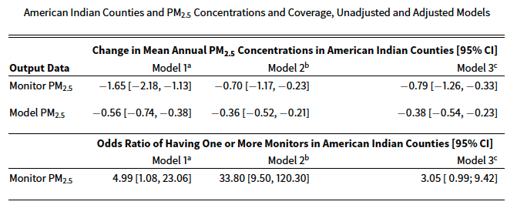
ªModel 1 adjusted for county type.
^{b}Model 2 adjusted for county type, population density.
^{c}Model 3 adjusted for county type, population density, median household income.

Slide 10
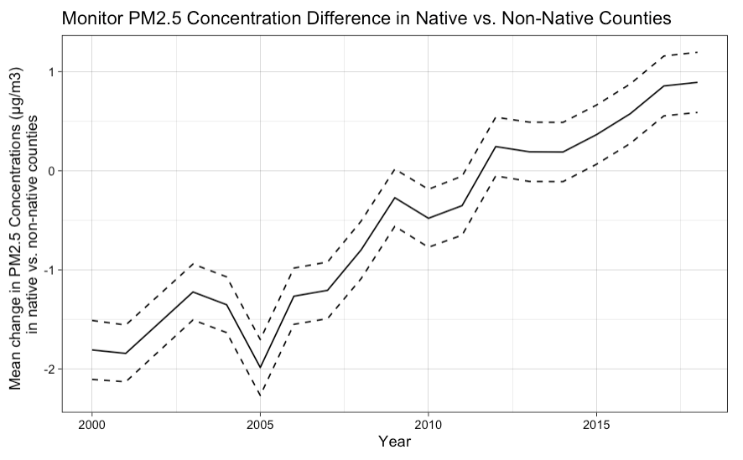
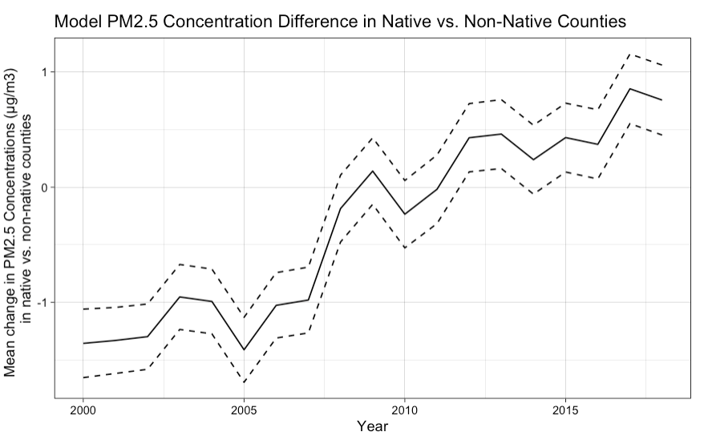
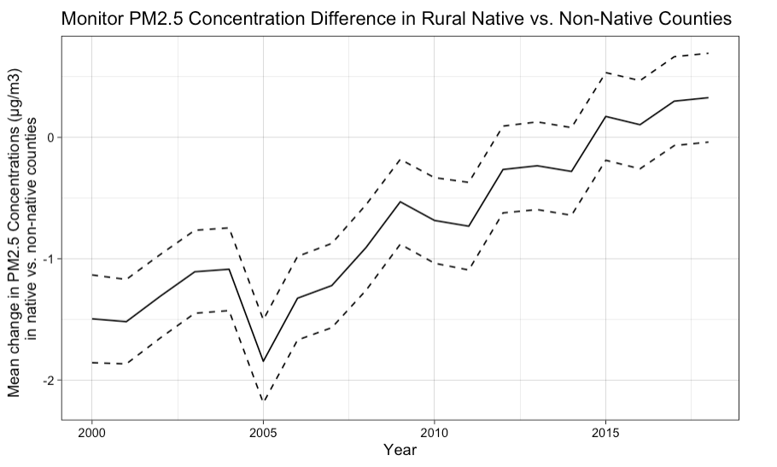
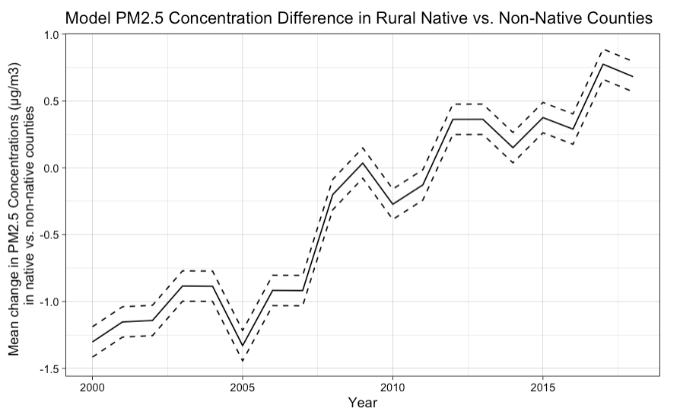

Slide 11
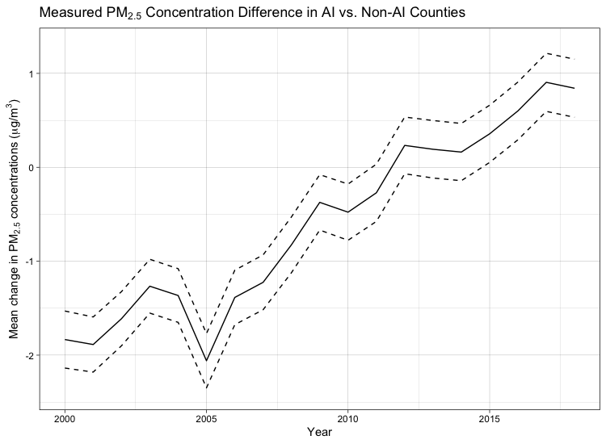
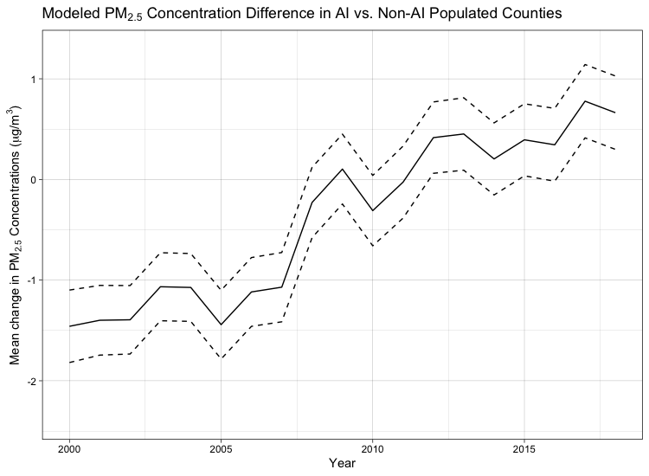
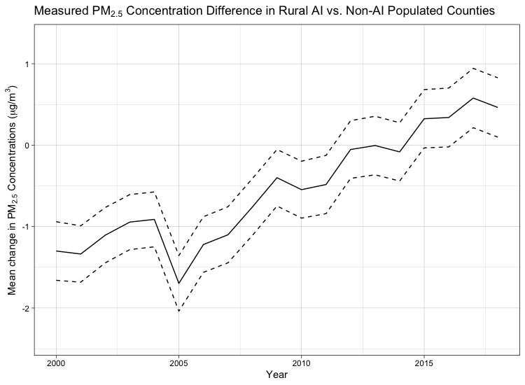
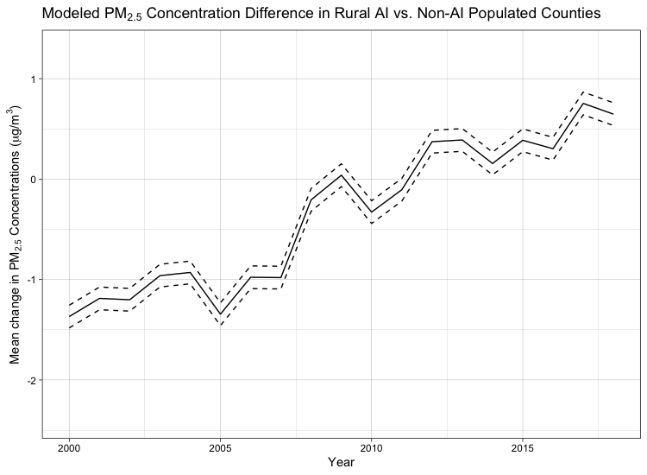

Slide 12
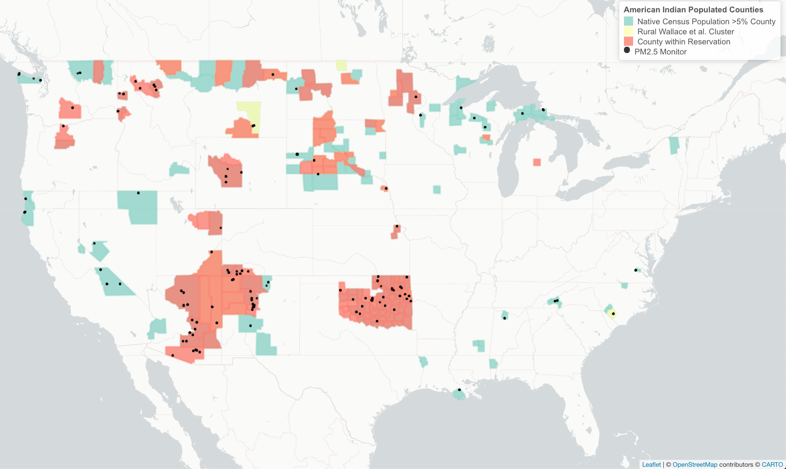
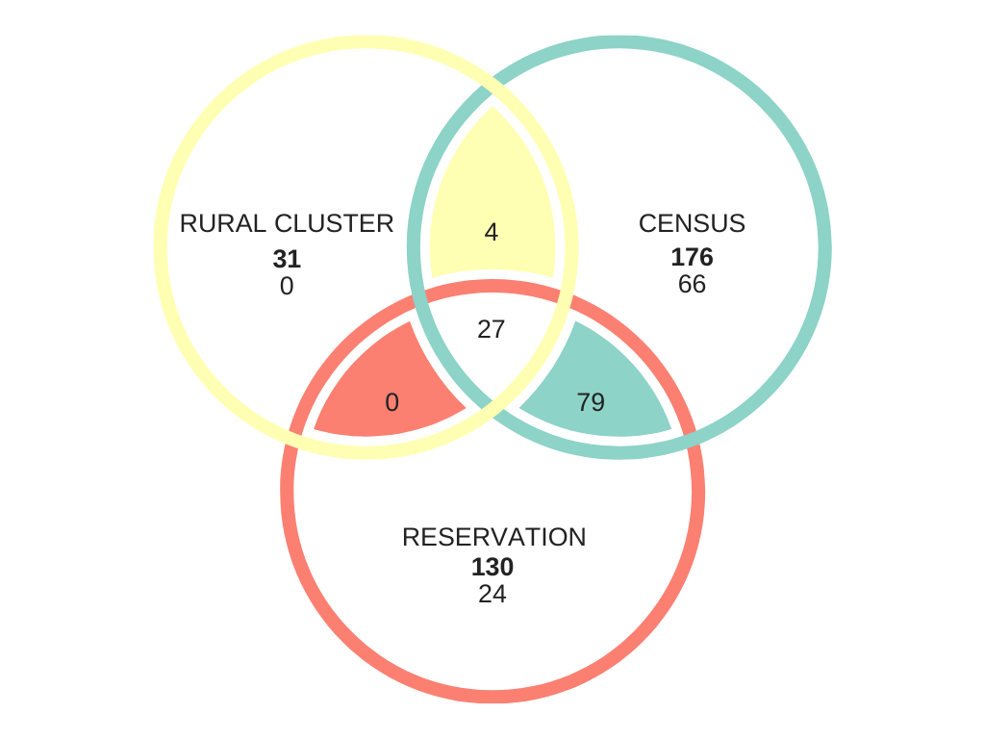

Slide 13
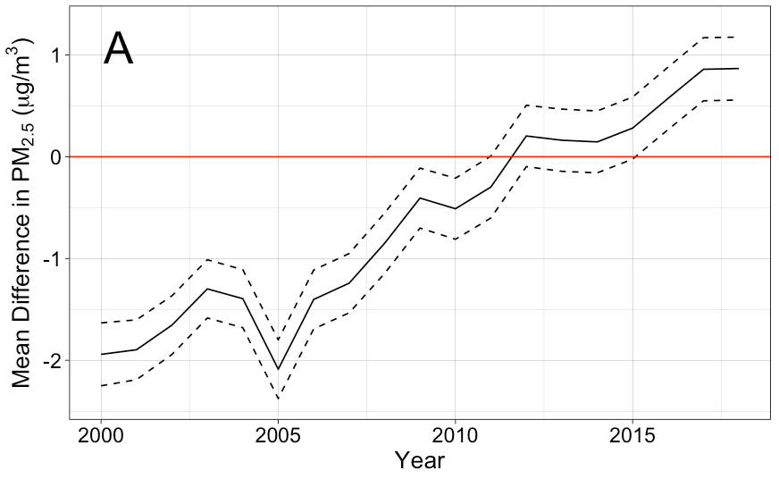
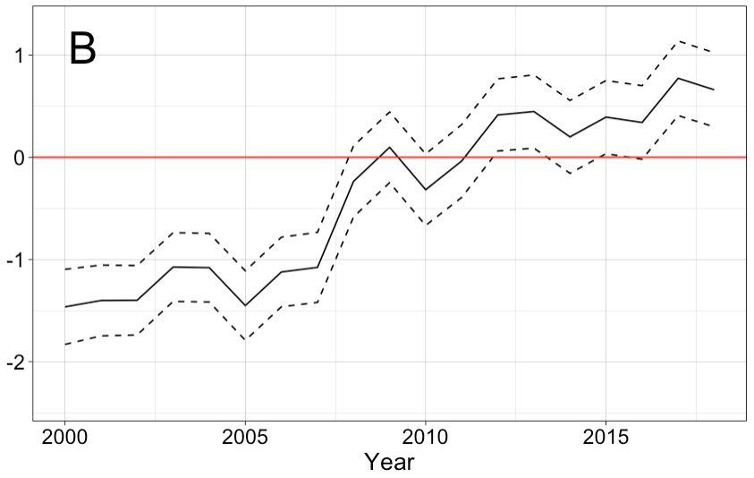

Slide 14
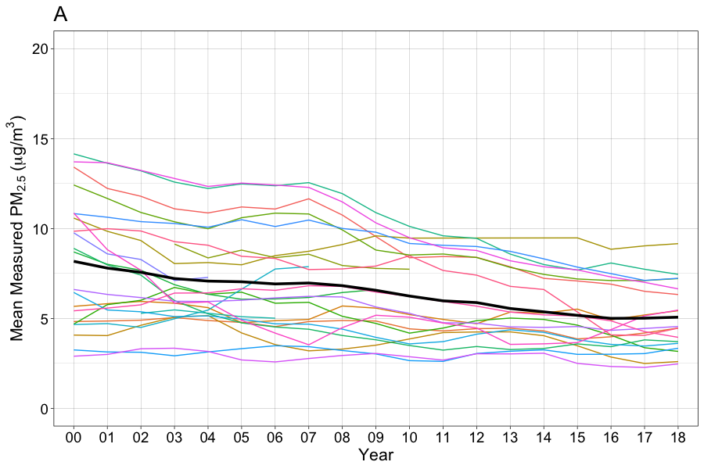
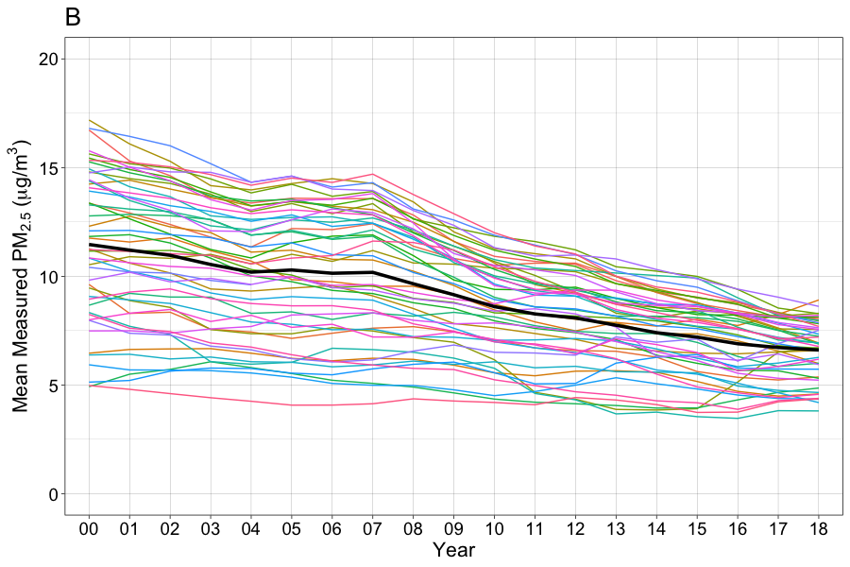
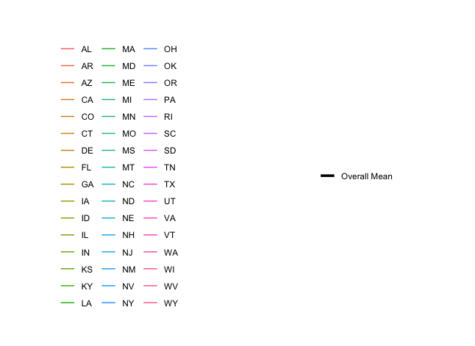
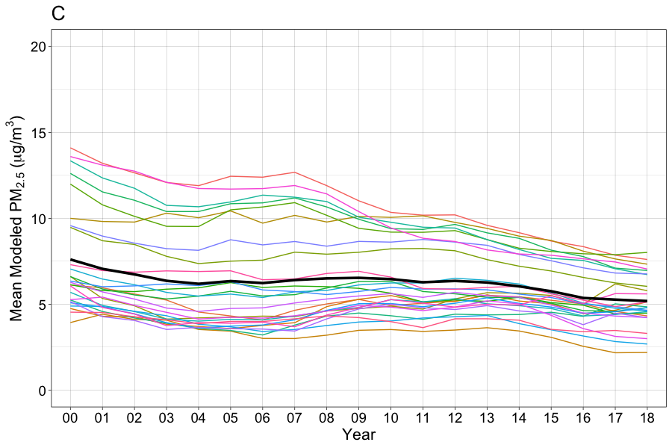
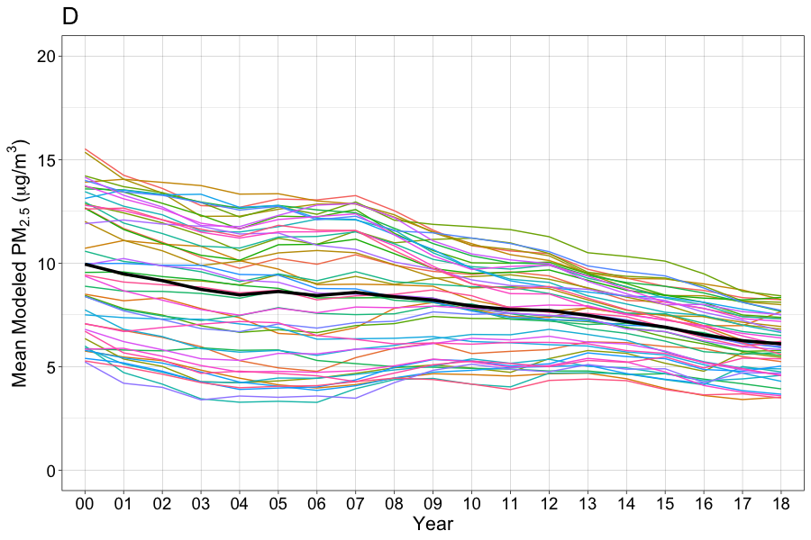

Slide 15
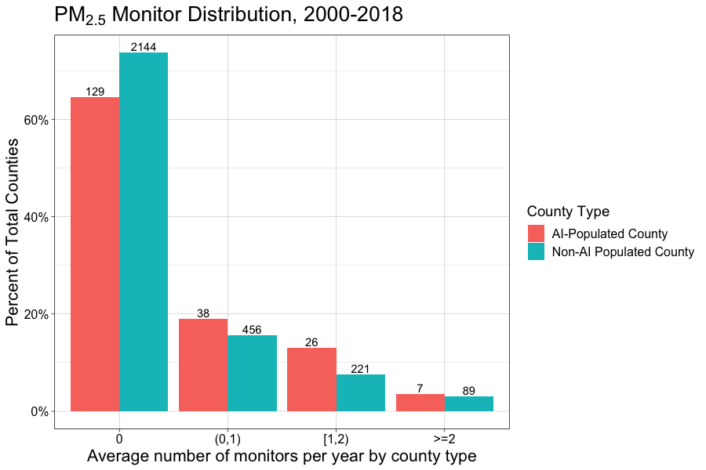

Slide 16
Lm models (no random intercepts)

Slide 17
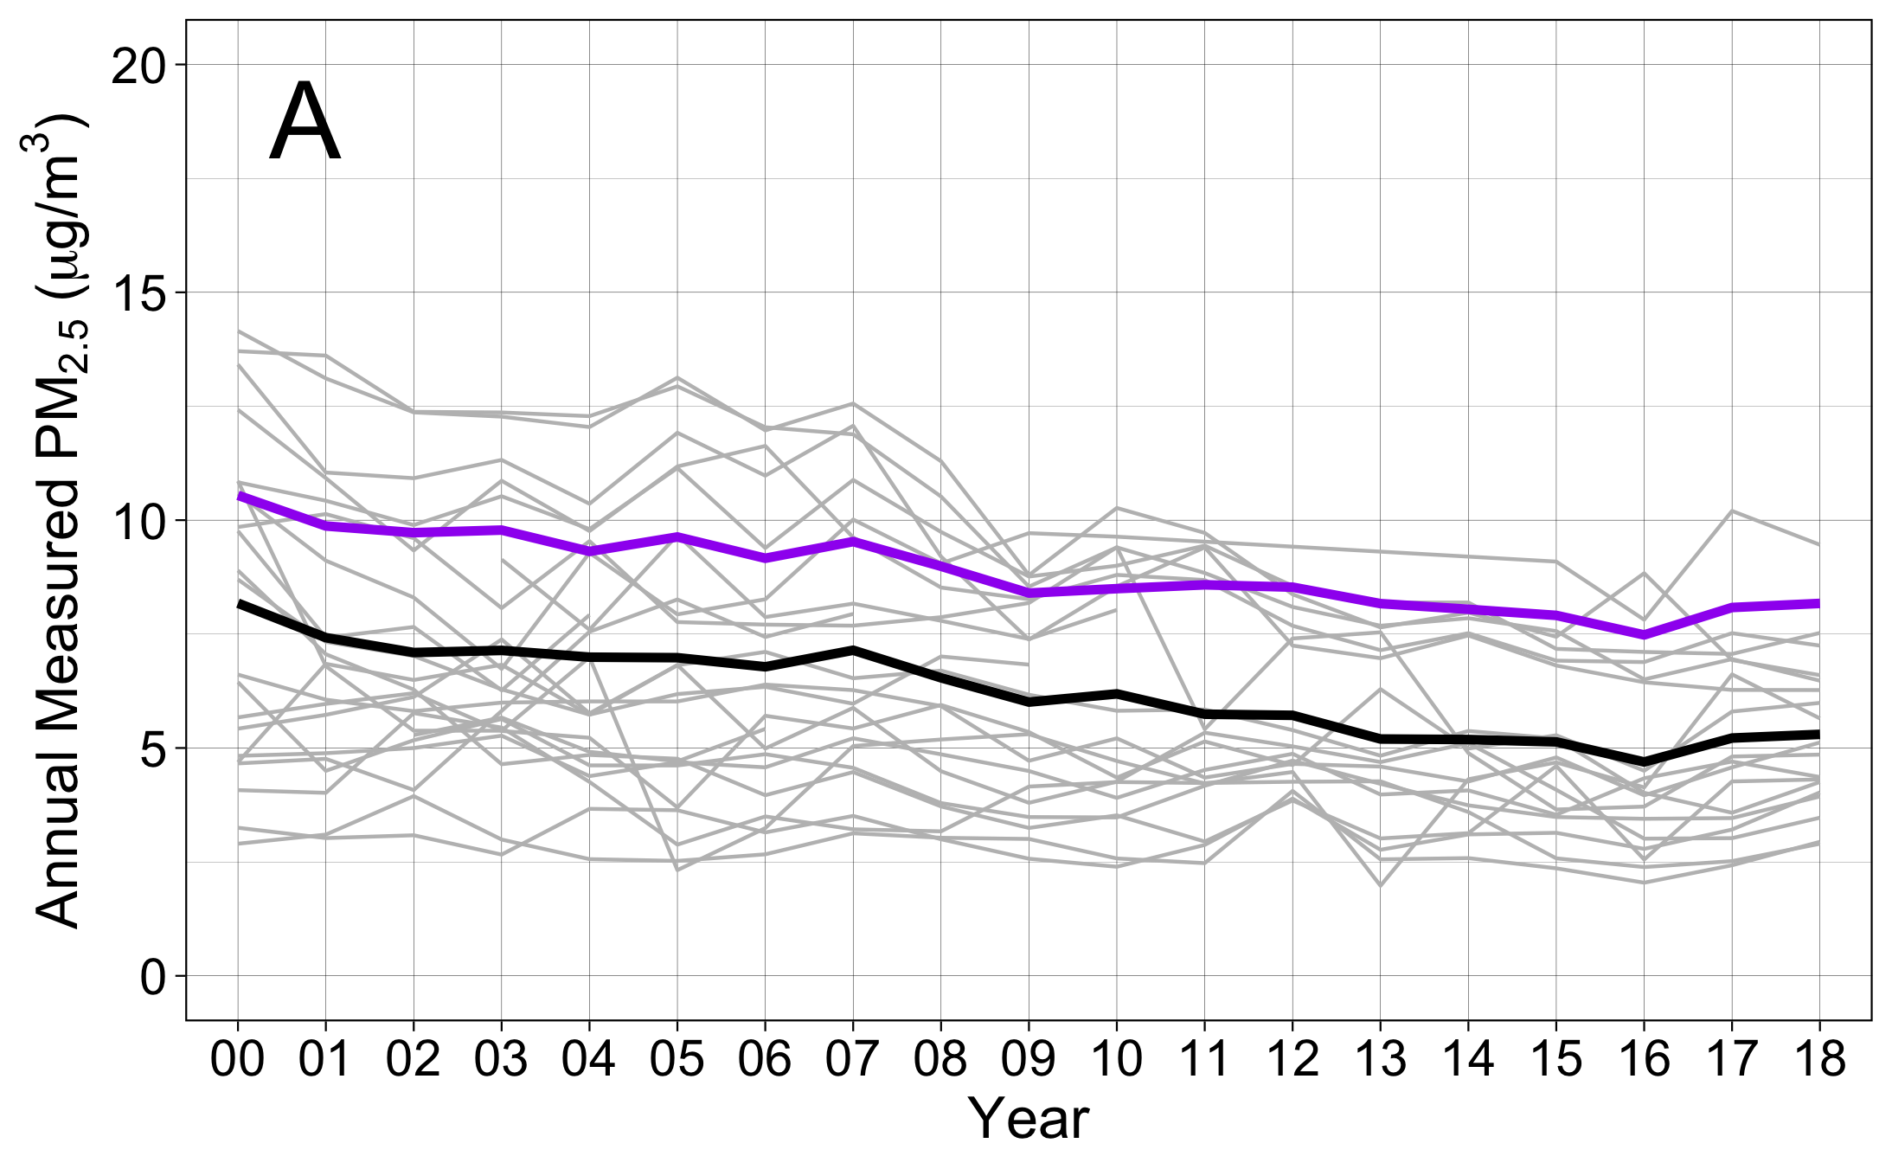
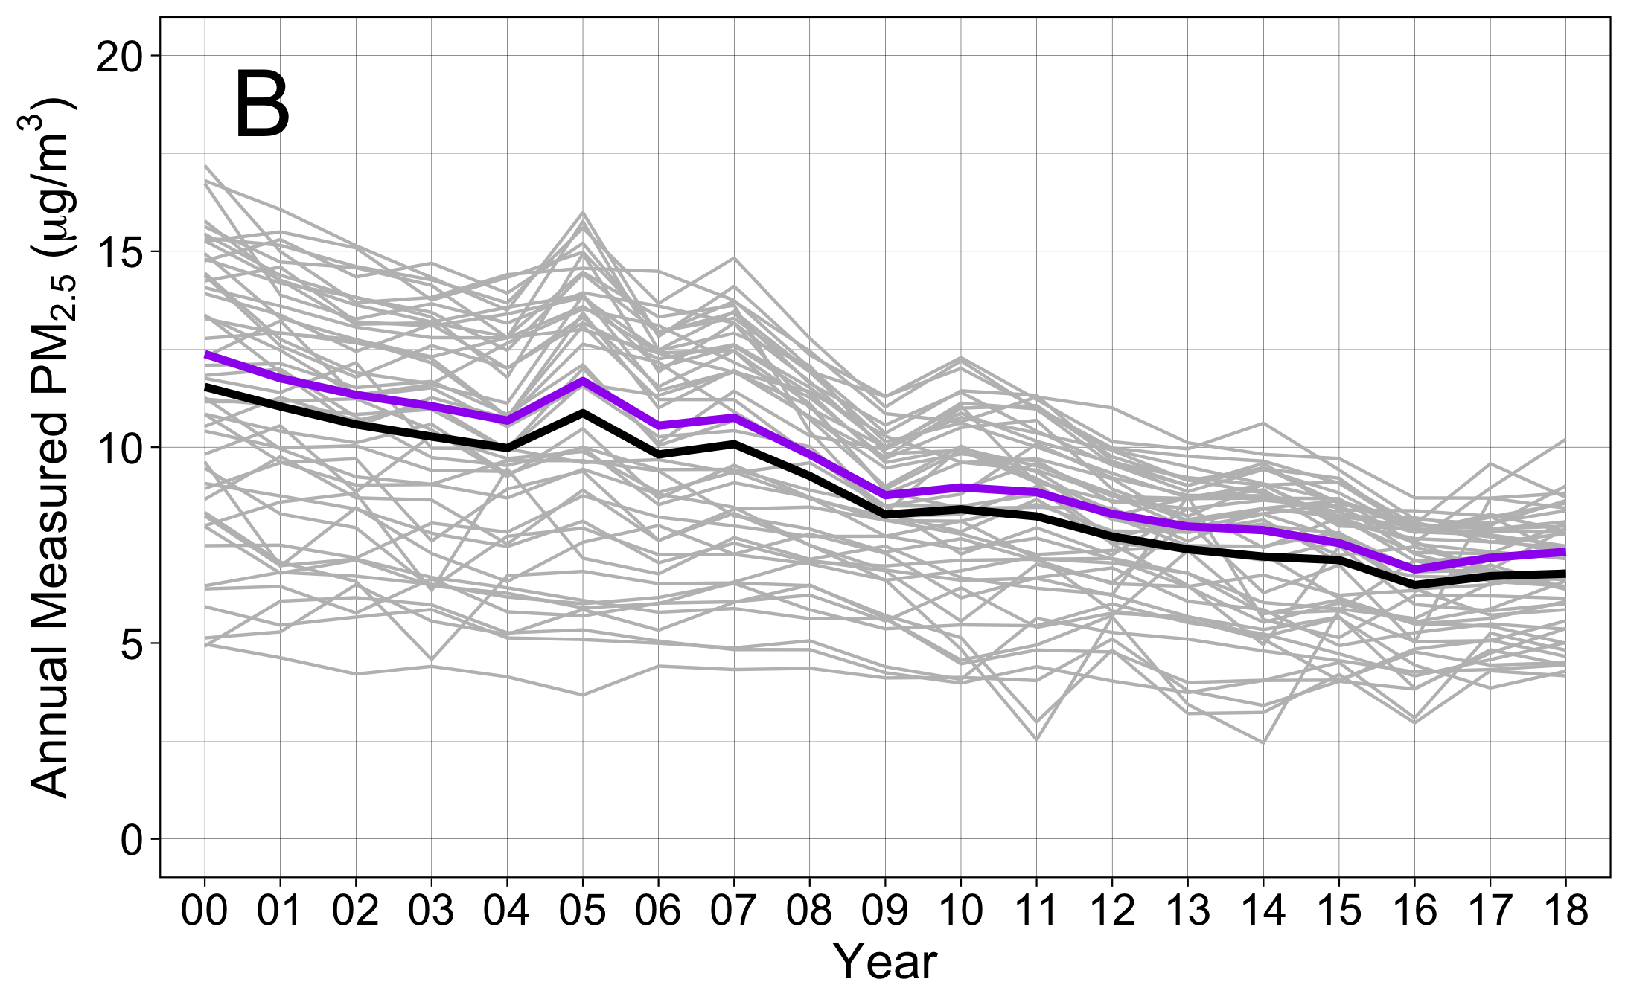
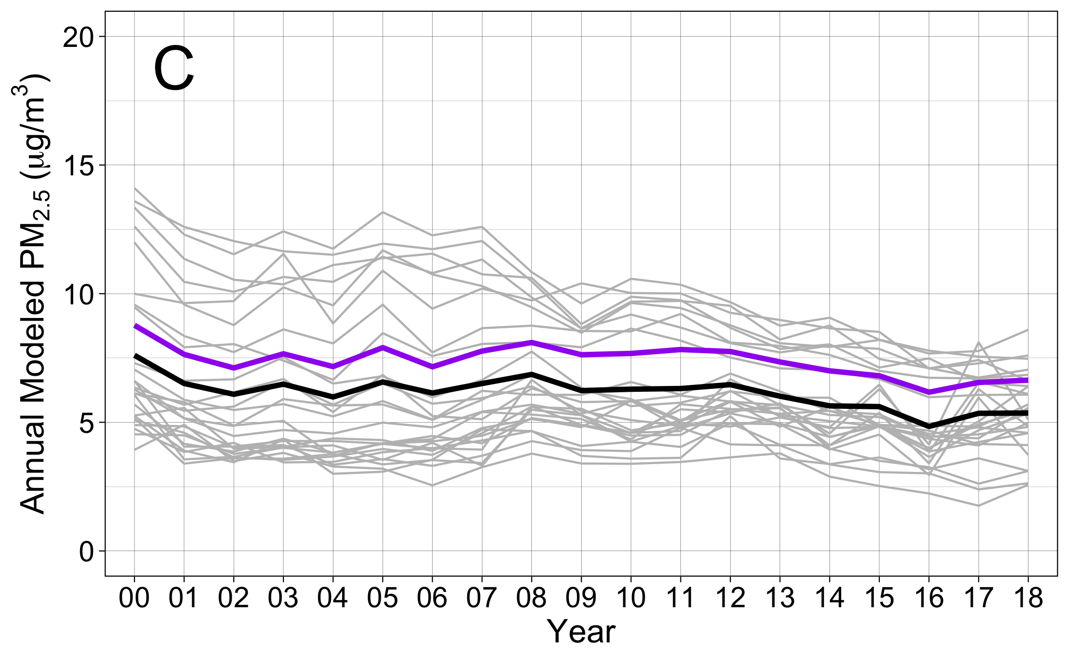
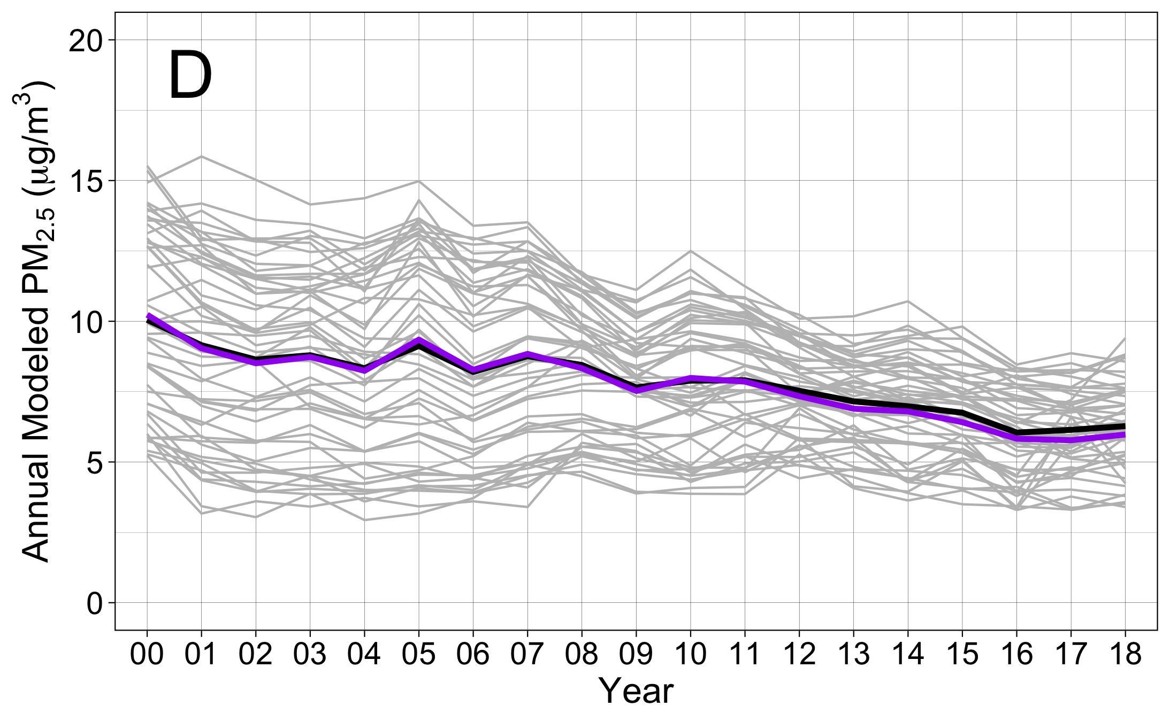
AI-Populated
Non-AI-Populated
Notes:
Gamm4 models (with random intercepts and adjusted)
updated 10.22

Slide 18
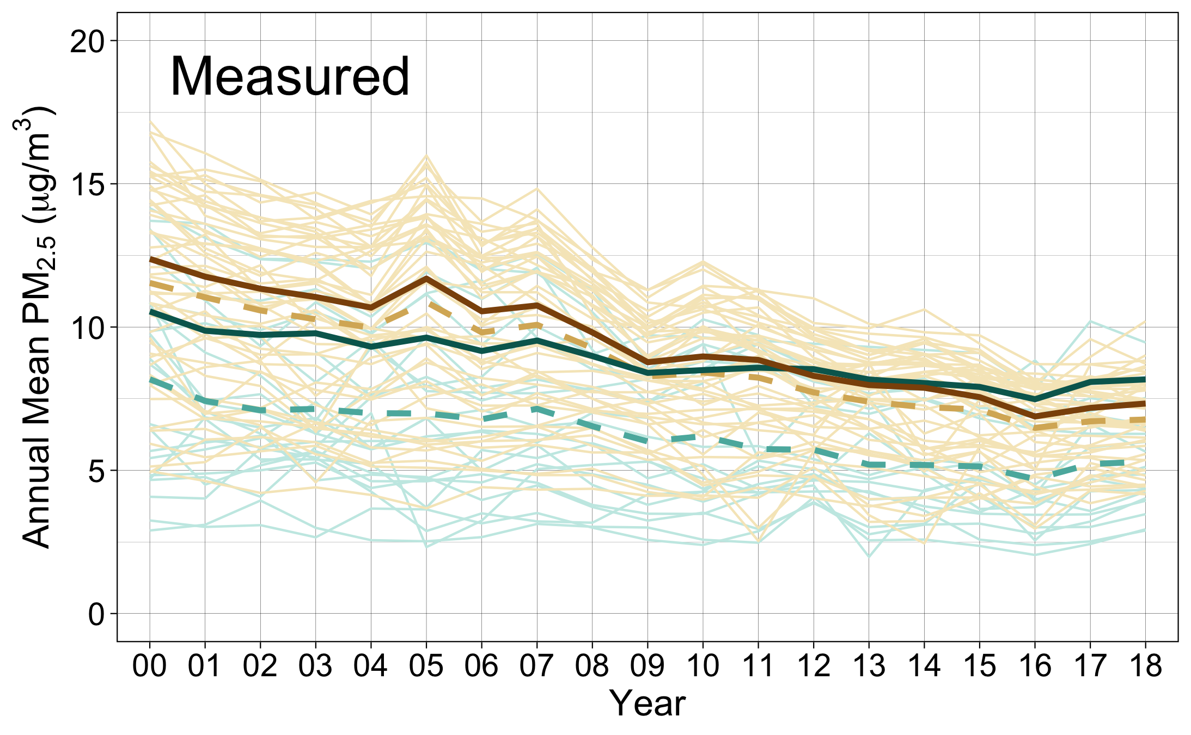
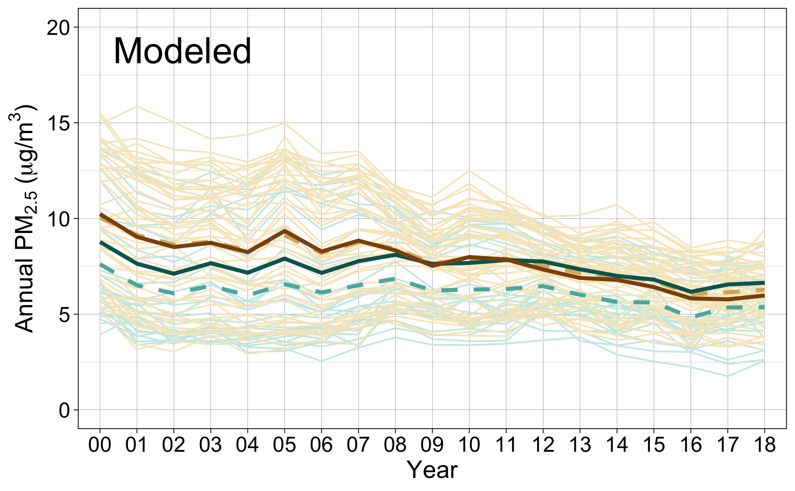
Non-AI populated counties
AI populated counties
Observed Annual Means by State
Observed Annual Means by State
Observed Annual Means (All States)
Observed Annual Means (All States)
Predicted Annual Means (Model 4)
Predicted Annual Means (Model 4)
Notes:
Combined AI/non-AI descriptive plots

Slide 19
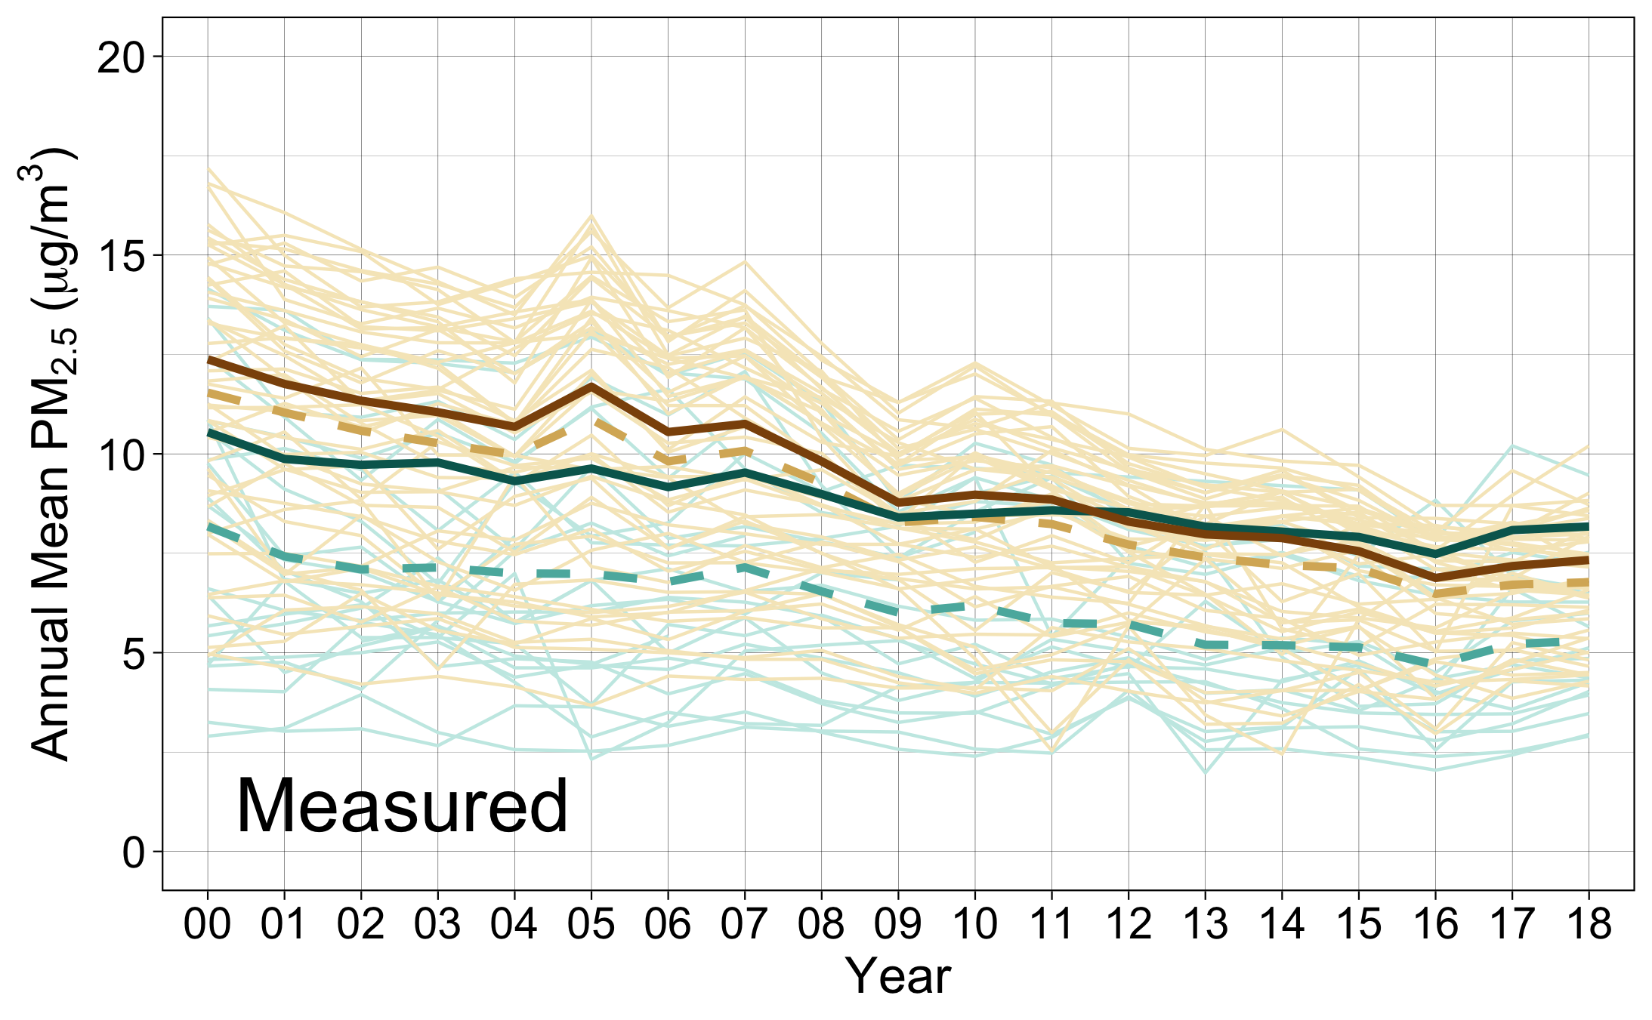
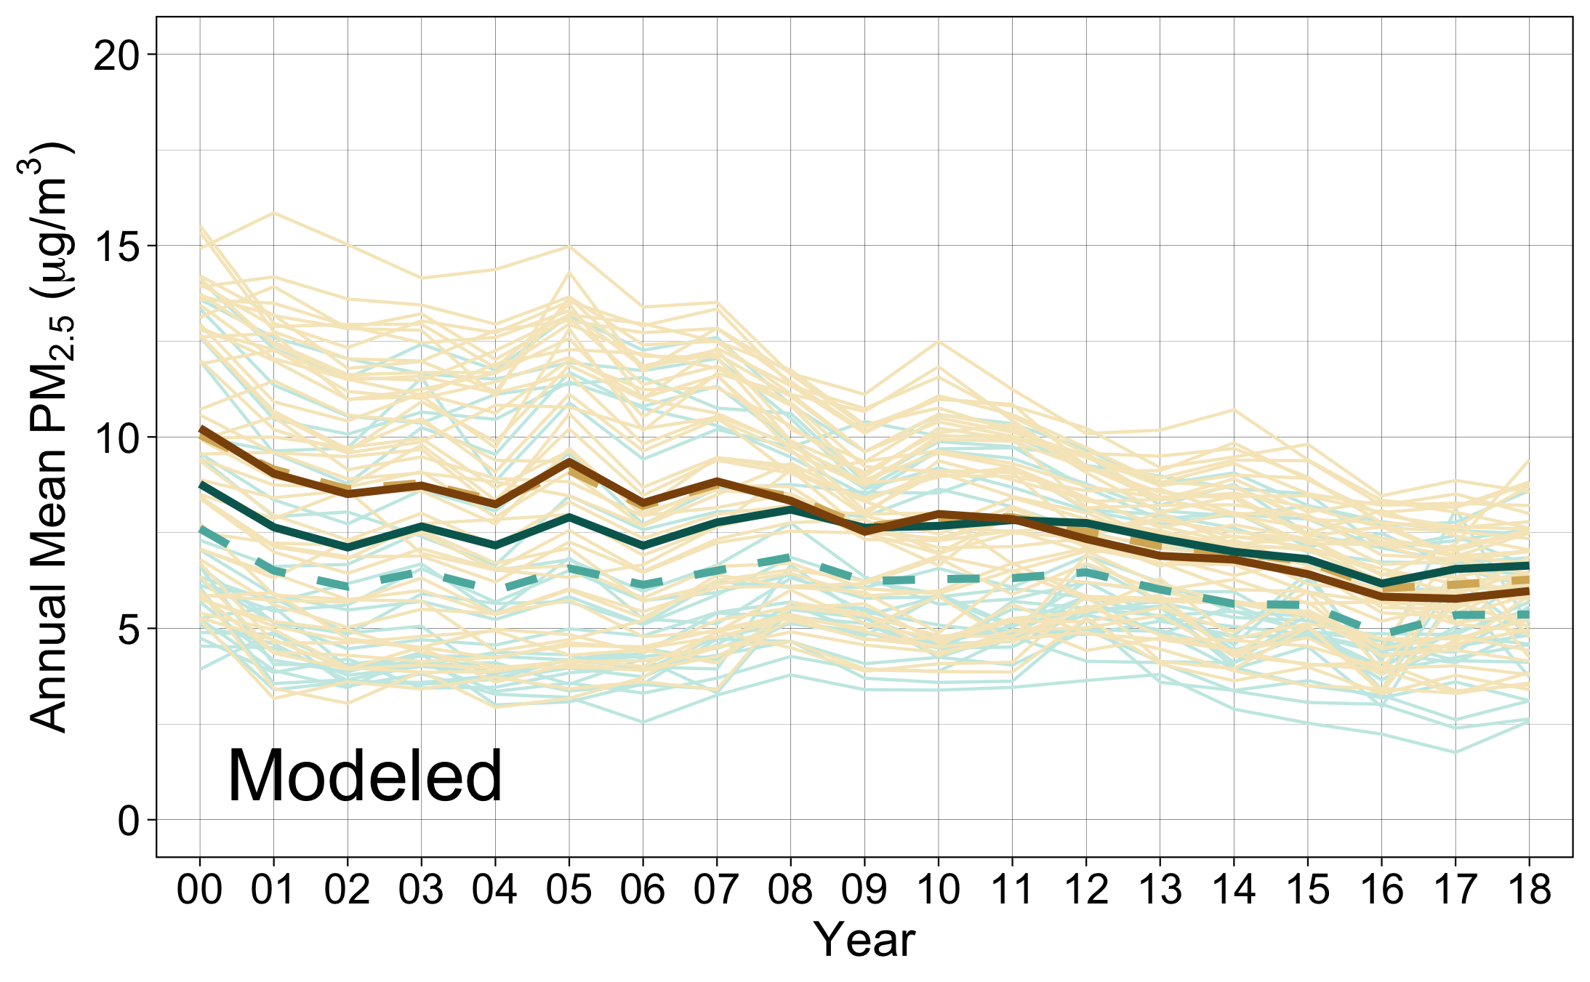
Non-AI-populated counties
AI-populated counties
Observed Annual Means by State
Observed Annual Means by State
Observed Annual Means (All States)
Observed Annual Means (All States)
Predicted Annual Means (Model 4)
Predicted Annual Means (Model 4)

Slide 20
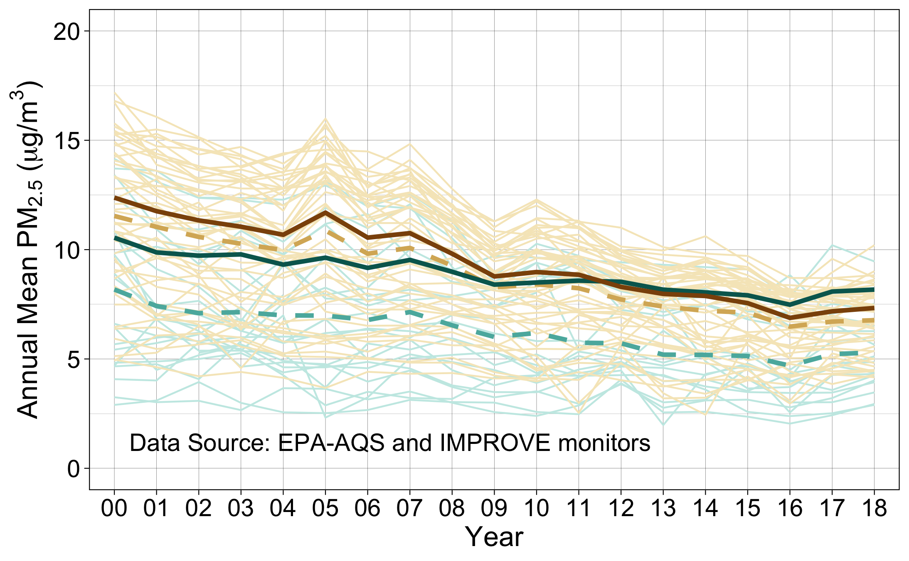
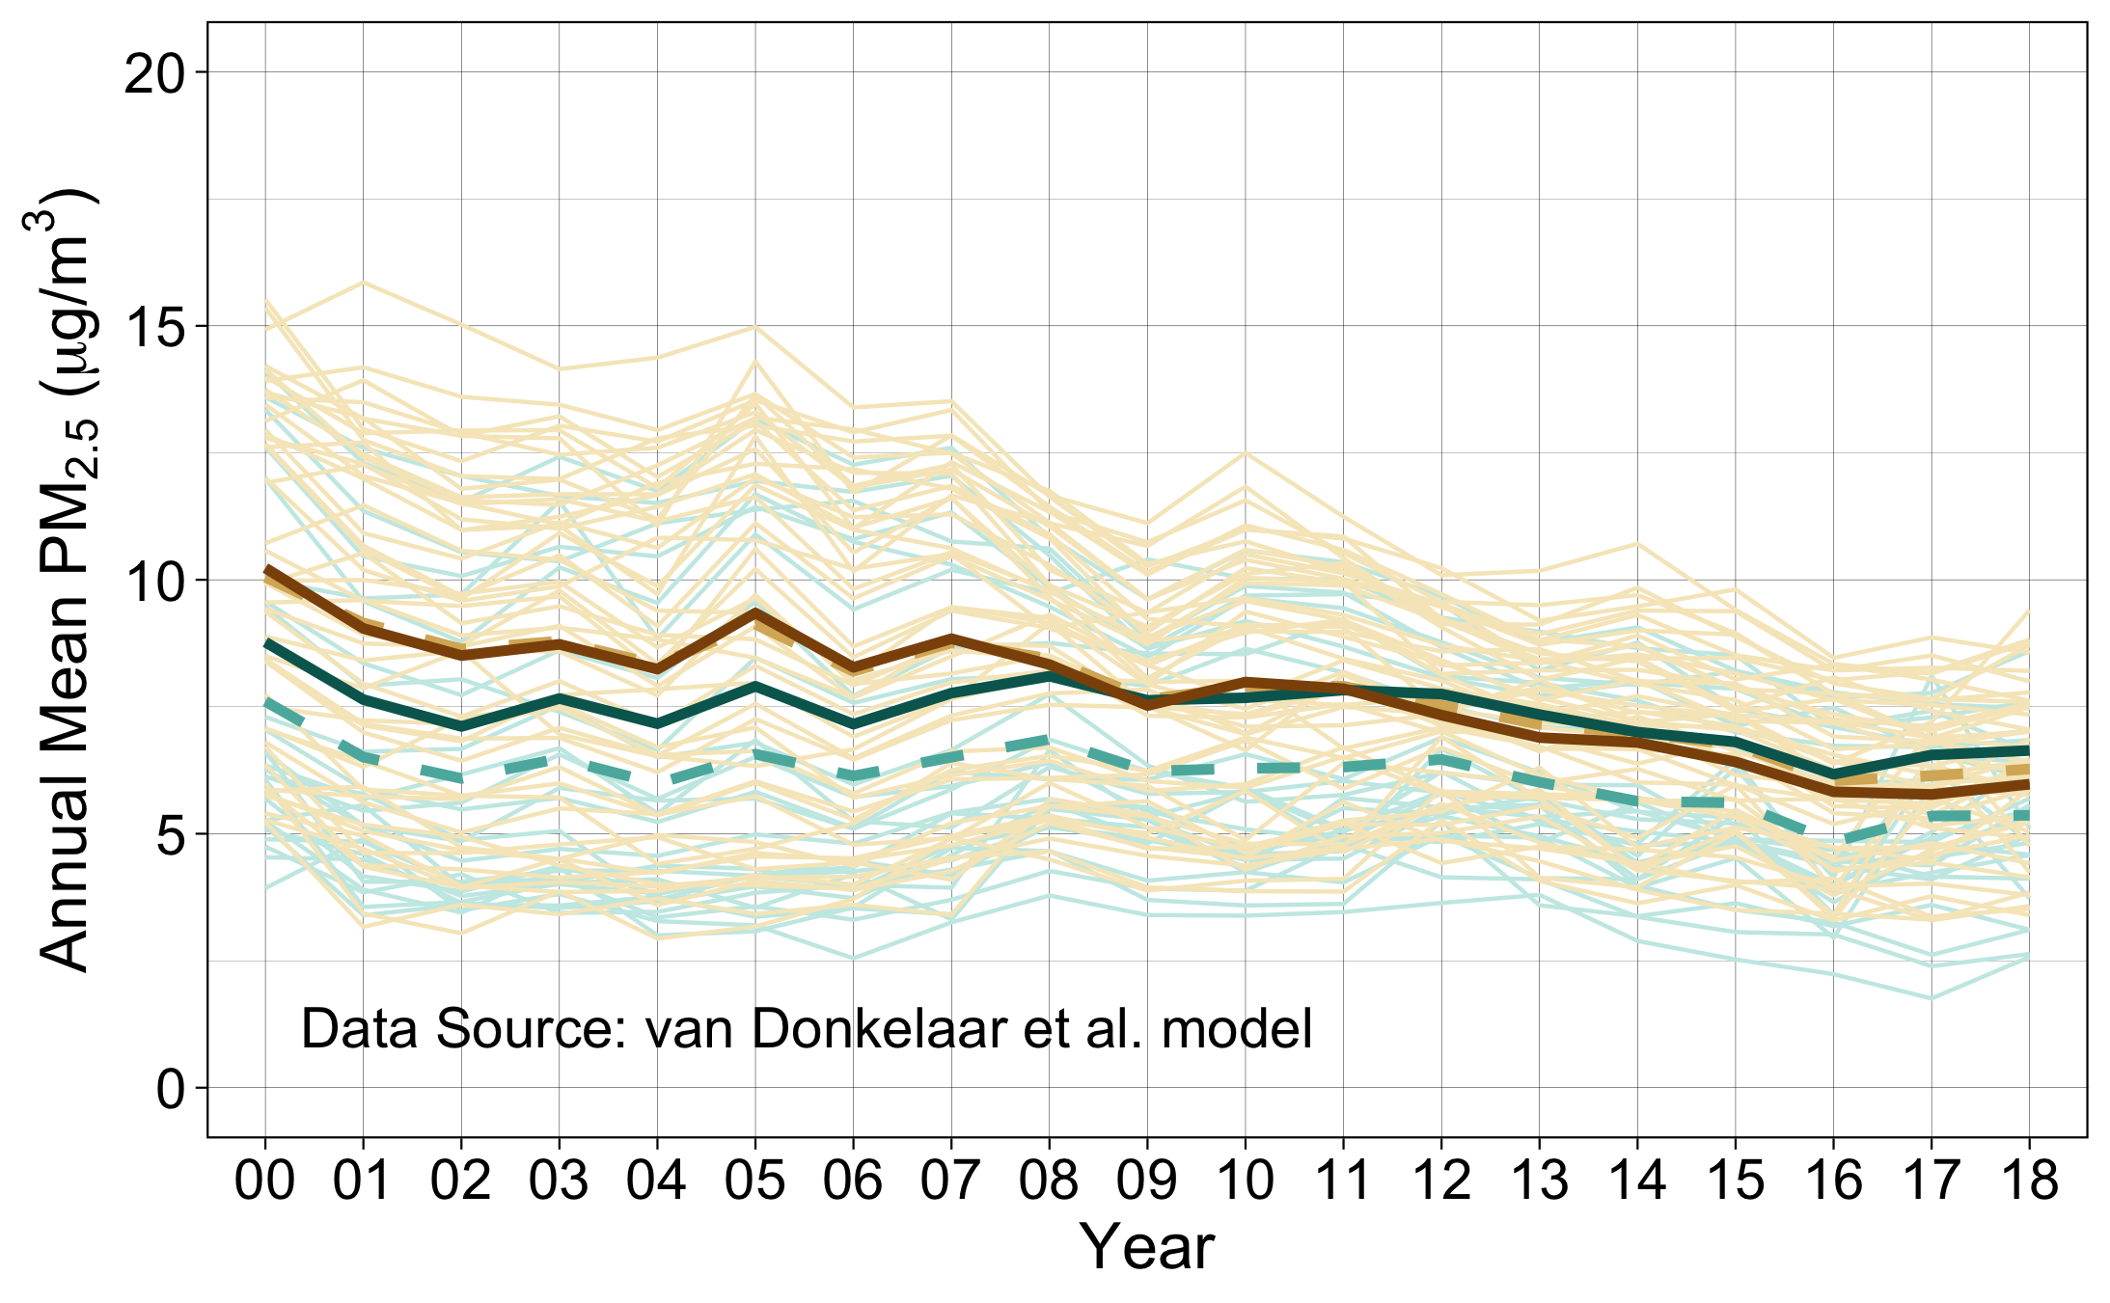
Non-AI-populated counties
AI-populated counties
Observed Annual Means by State
Observed Annual Means by State
Observed Annual Means (All States)
Observed Annual Means (All States)
Estimated Annual Means (Model 4)
Estimated Annual Means (Model 4)

Slide 21
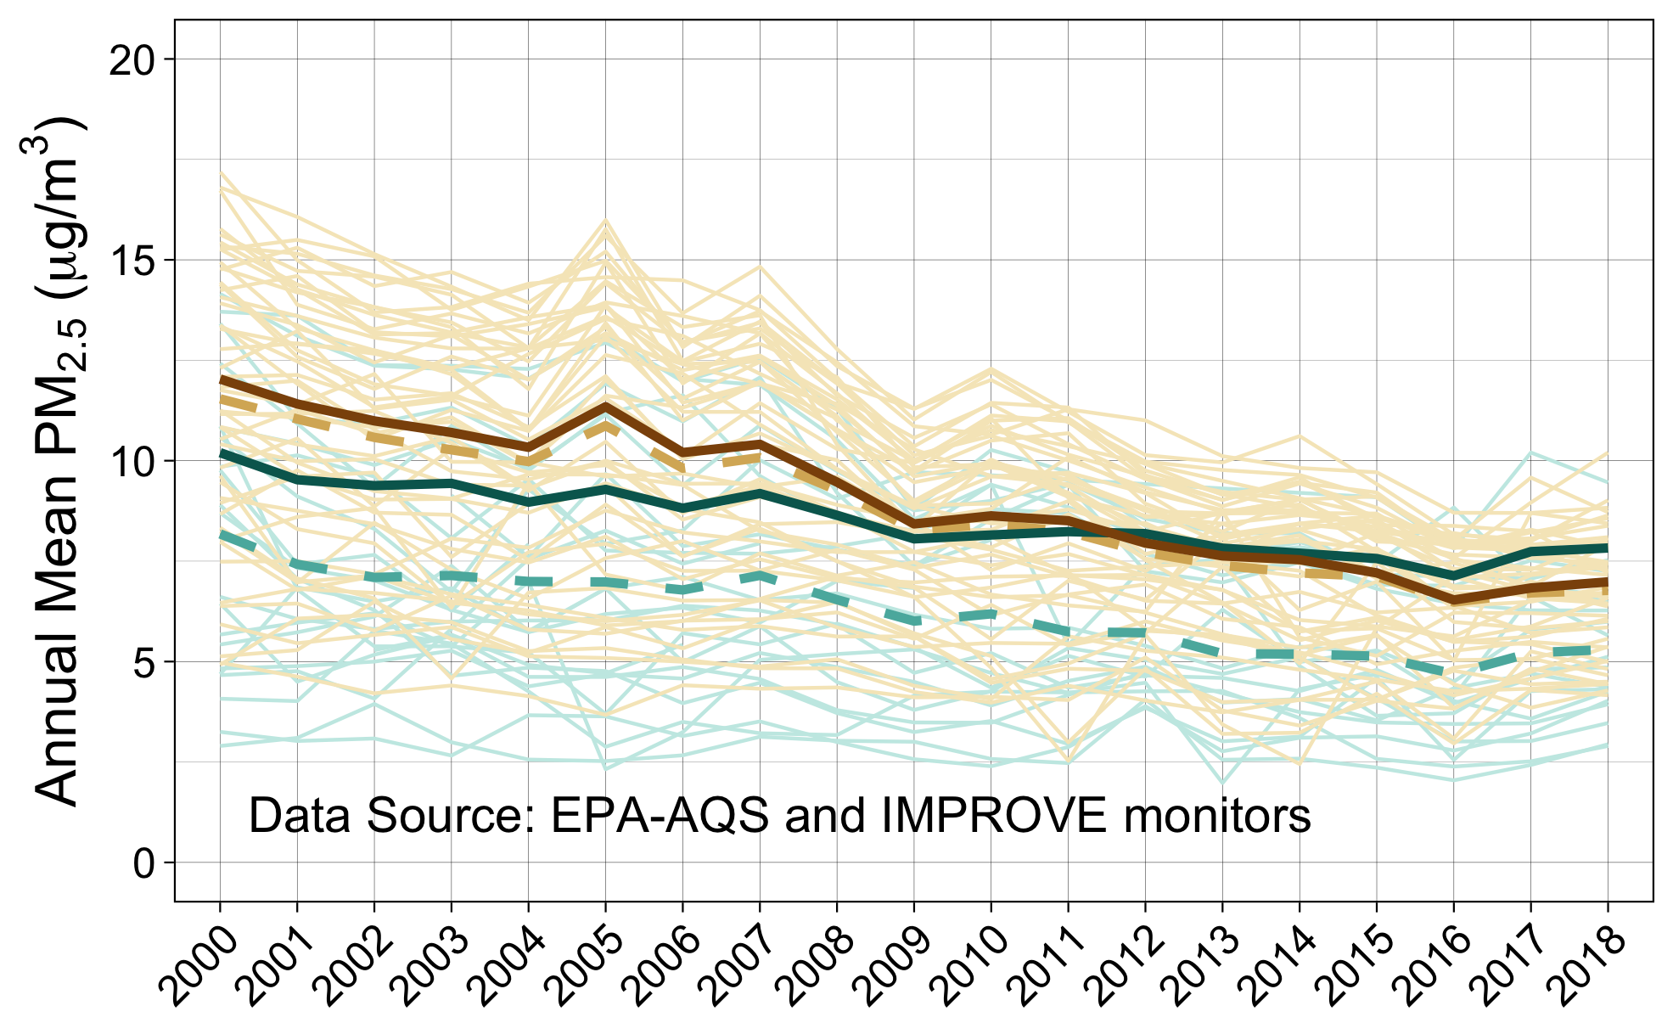
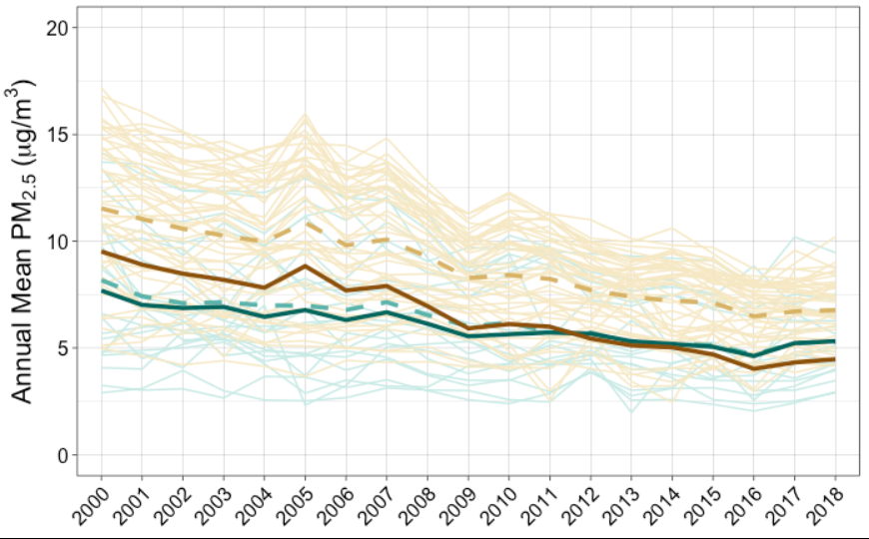
Non-AI-populated counties
AI-populated counties
Observed Annual Means by State
Observed Annual Means by State
Observed Annual Means (All States)
Observed Annual Means (All States)
Estimated Annual Means (Model 4)
Estimated Annual Means (Model 4)
Using most common non-AI decile covariate values
Using most common AI decile covariate values
Notes:
Comparing using different decile groups for predicting measured PM2.5
→ You can see the only difference is the shift of the adjusted AI/non-AI bolded lines up and down. They maintain the same relative relationship with one another

Slide 22
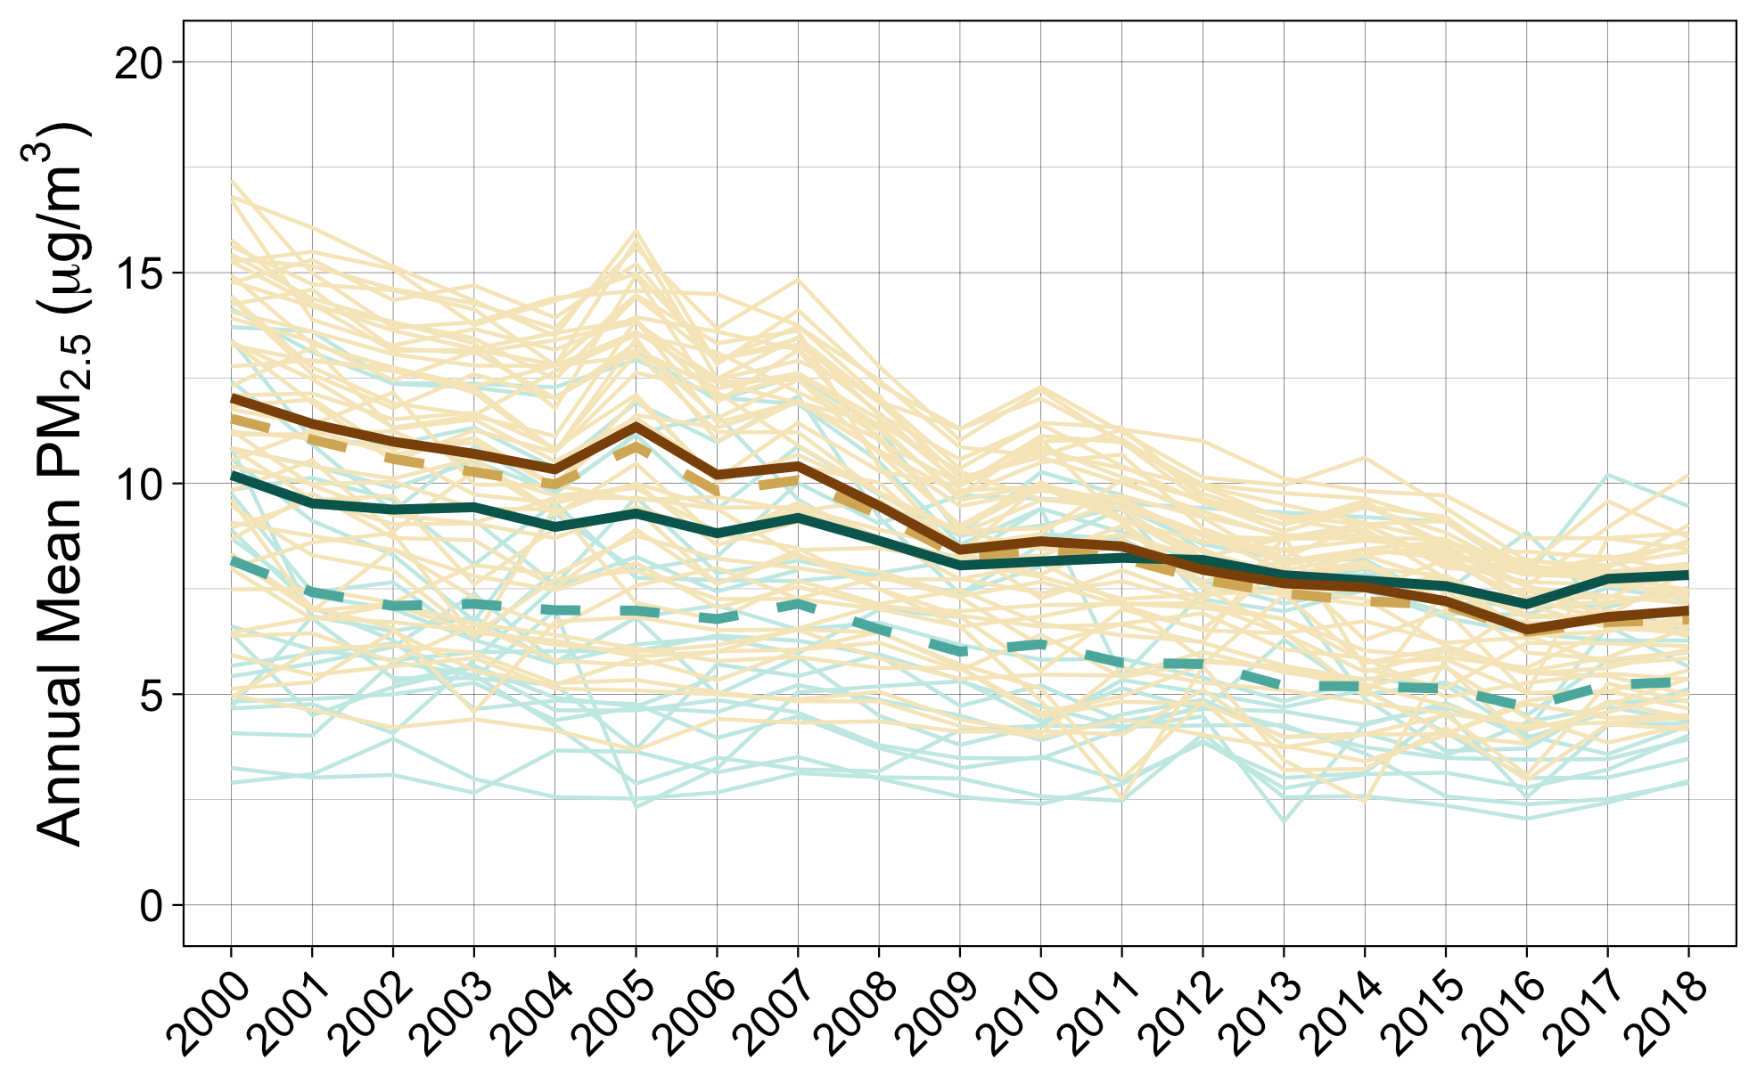
Non-AI-populated counties
AI-populated counties
Raw Annual Means by State
Raw Annual Means by State
Raw Annual Means (All States)
Raw Annual Means (All States)
Estimated Annual Means (All States)
Estimated Annual Means (All States)
Notes:
Measured pm2.5 for the grant (short title)

Slide 23
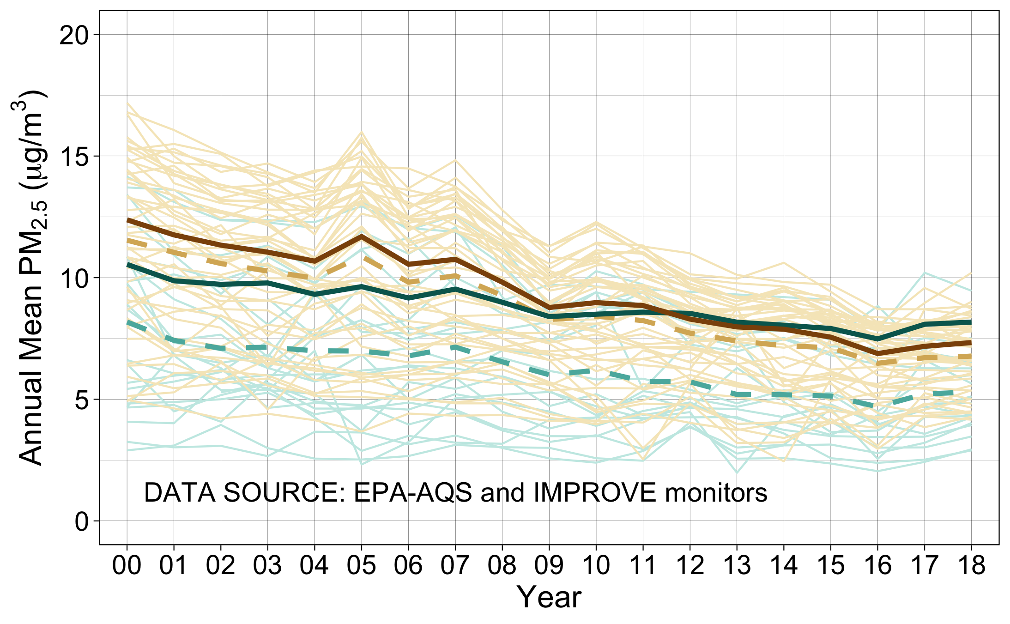
Non-AI-populated counties
AI-populated counties
Observed Annual Means by State
Observed Annual Means by State
Observed Annual Means (All States)
Observed Annual Means (All States)
Predicted Annual Means (Model 4)
Predicted Annual Means (Model 4)
Notes:
Measured pm2.5 for the grant (data source)

Slide 24
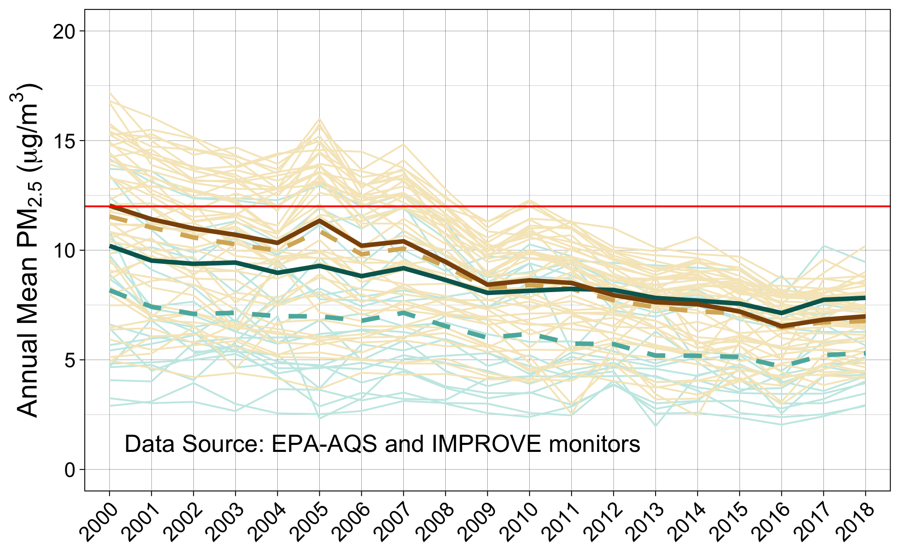
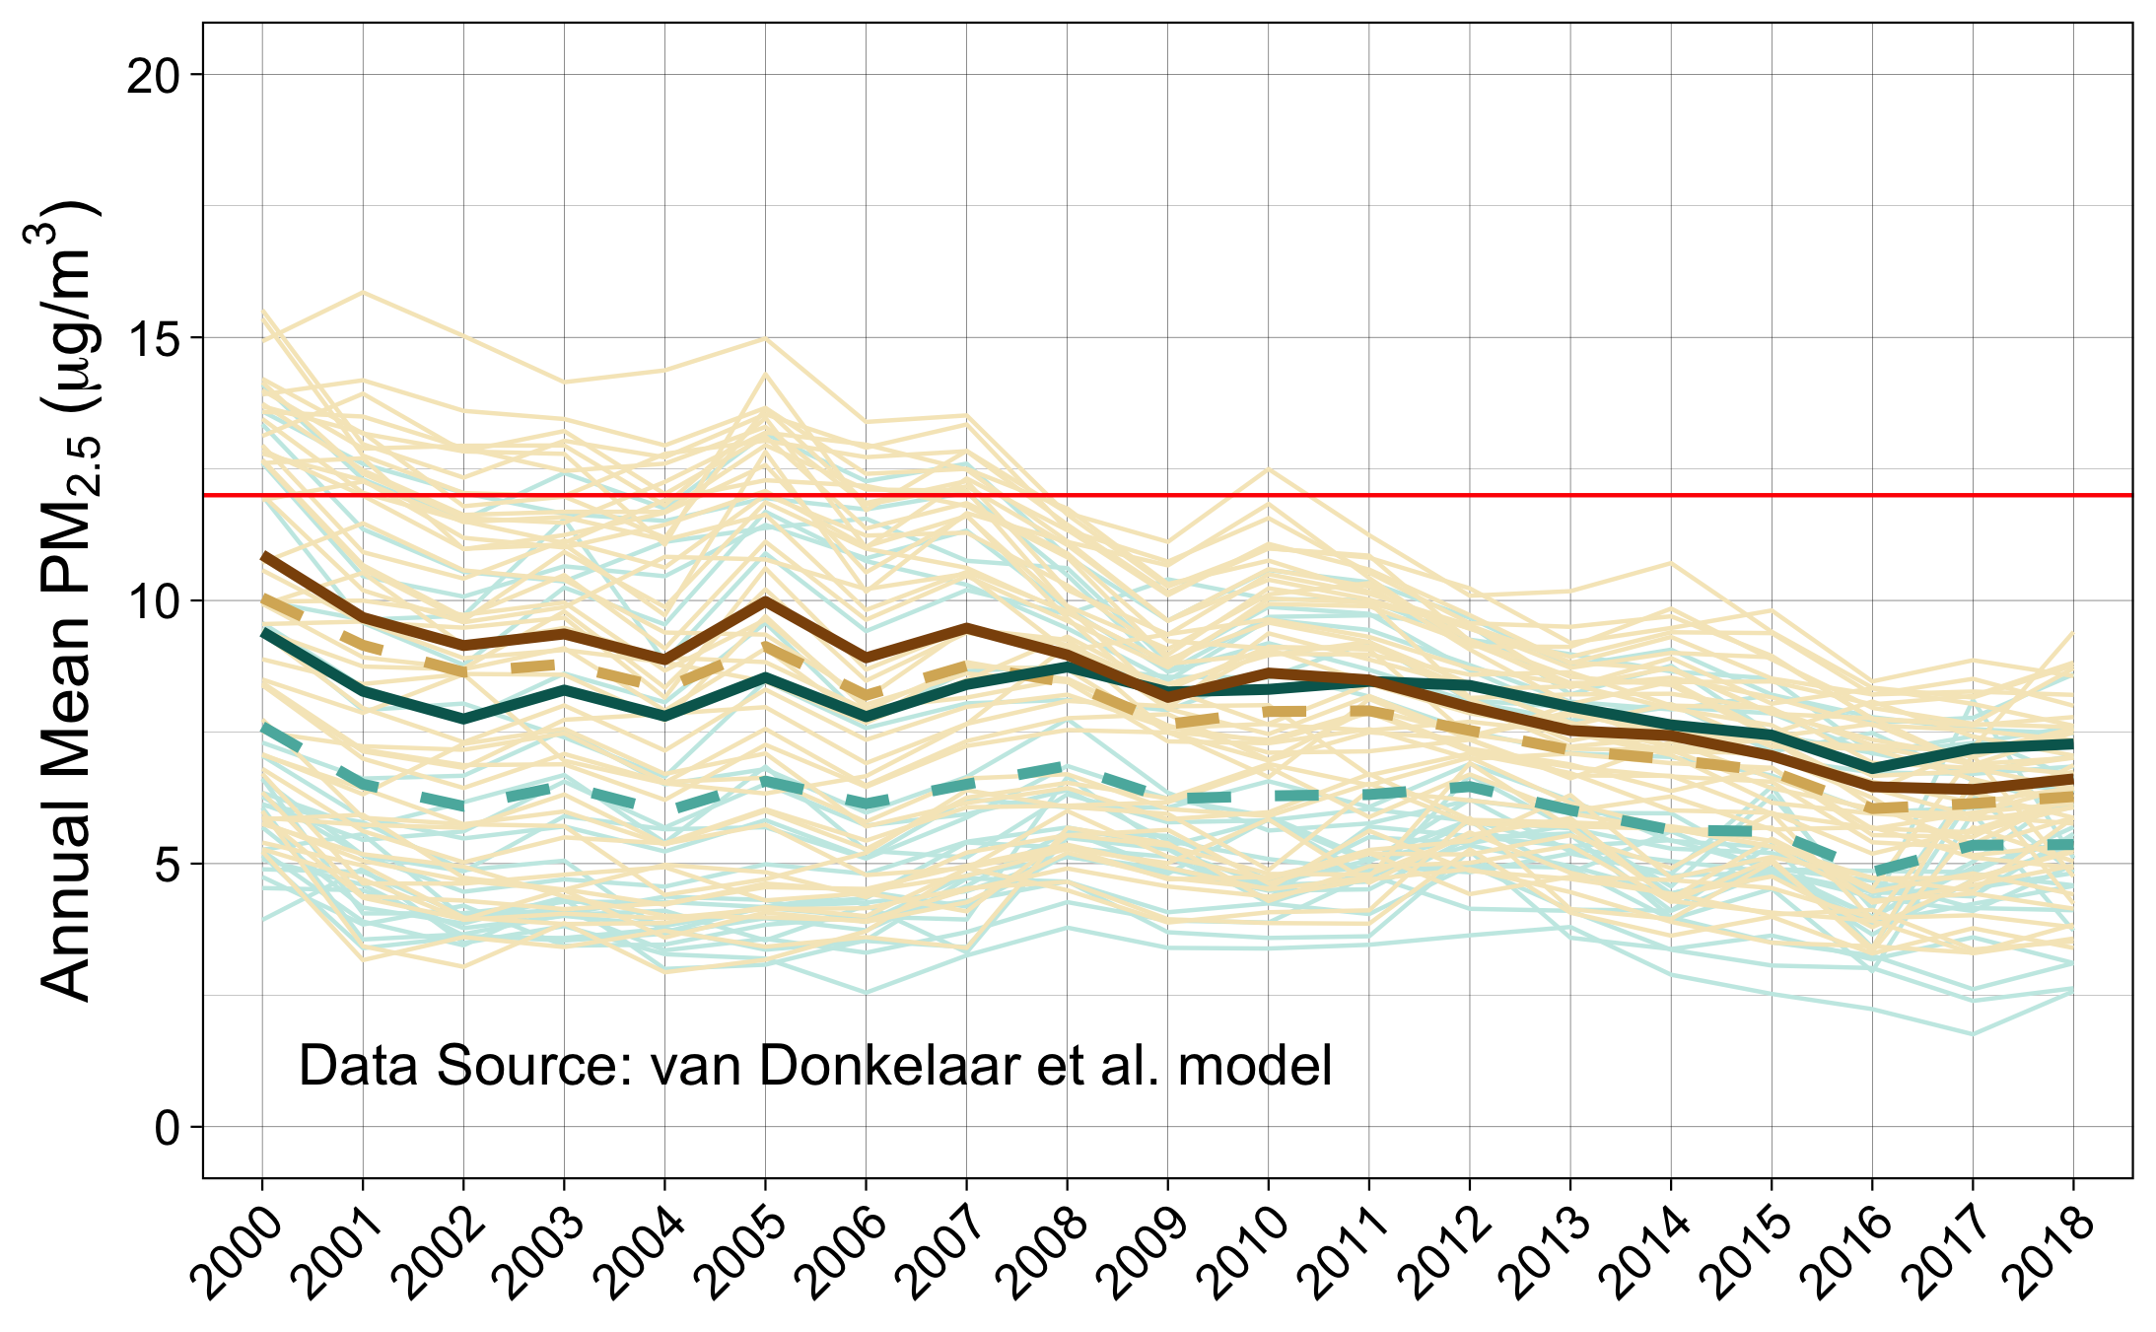
Non-AI-populated counties
AI-populated counties
Non-AI-populated counties
AI-populated counties
Observed Annual Means by State
Observed Annual Means by State
Observed Annual Means by State
Observed Annual Means by State
Observed Annual Means (All States)
Observed Annual Means (All States)
Observed Annual Means (All States)
Observed Annual Means (All States)
Estimated Annual Means (Model 4)
Estimated Annual Means (Model 4)
Estimated Annual Means (Model 4)
Estimated Annual Means (Model 4)
Notes:
For manuscript

Slide 25
Non-AI-populated counties
AI-populated counties
Non-AI-populated counties
AI-populated counties
Observed Annual Means by State
Observed Annual Means by State
Observed Annual Means by State
Observed Annual Means by State
Observed Annual Means (All States)
Observed Annual Means (All States)
Observed Annual Means (All States)
Observed Annual Means (All States)
Estimated Annual Means (Model 4)
Estimated Annual Means (Model 4)
Estimated Annual Means (Model 4)
Estimated Annual Means (Model 4)
Notes:
For manuscript, flipped monitor and model graphs

Slide 26
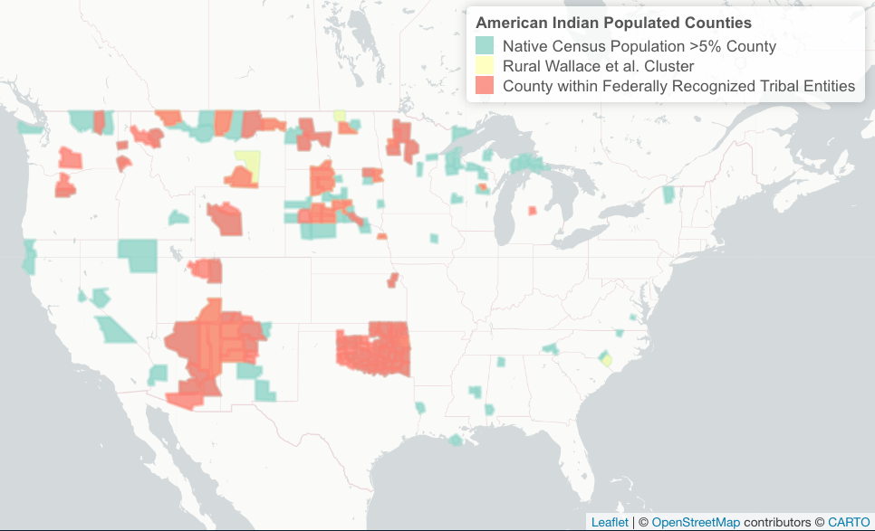

Rural Cluster
Federally recognized tribal entity
Census
0
4
0
27
79
66
23
Rural Cluster
Reservation
Census

Slide 27
Rural Cluster
Federally recognized tribal entity
Census
0
3
0
28
79
66
23
Rural Cluster
Reservation
Census
Notes:
Edited color scheme of map and venn diagram to have multiple colors

Slide 28
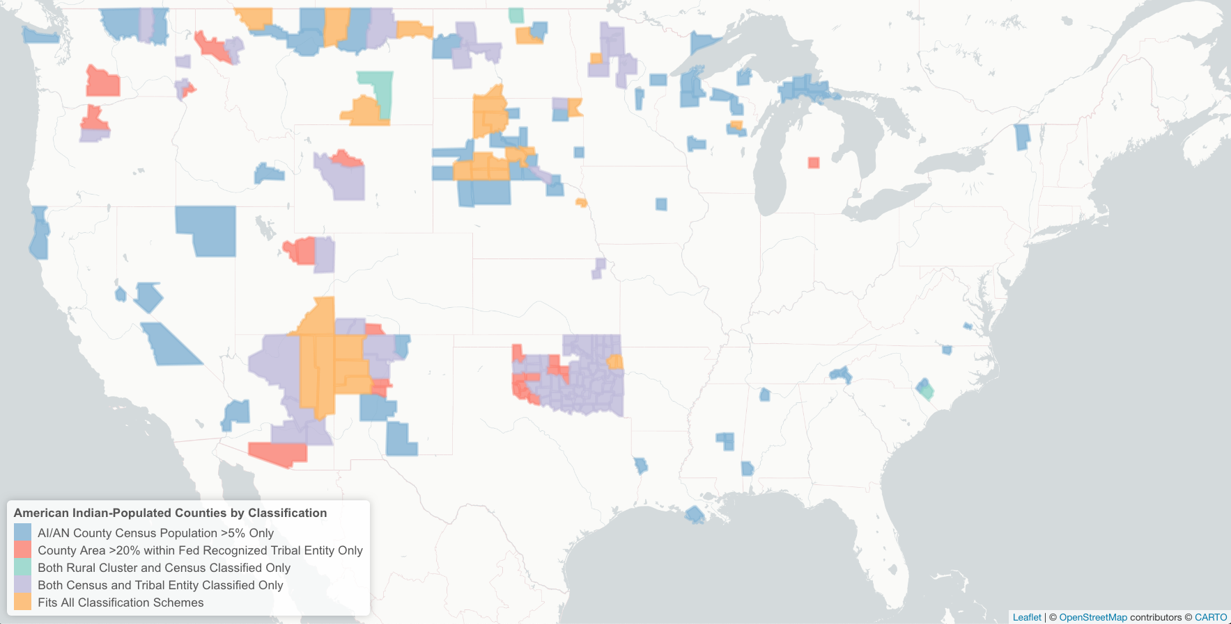
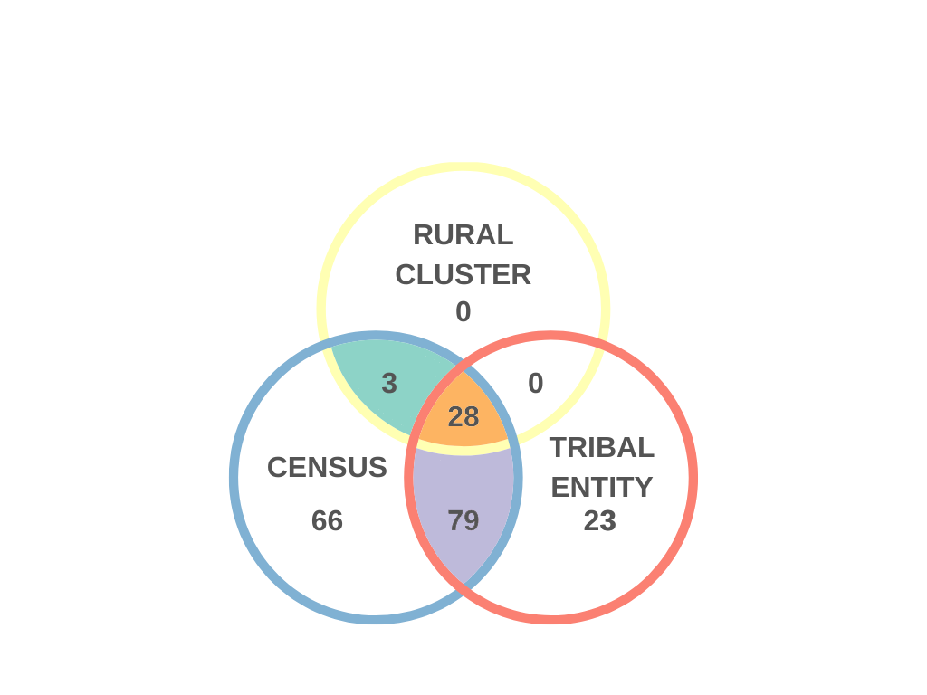

Slide 29
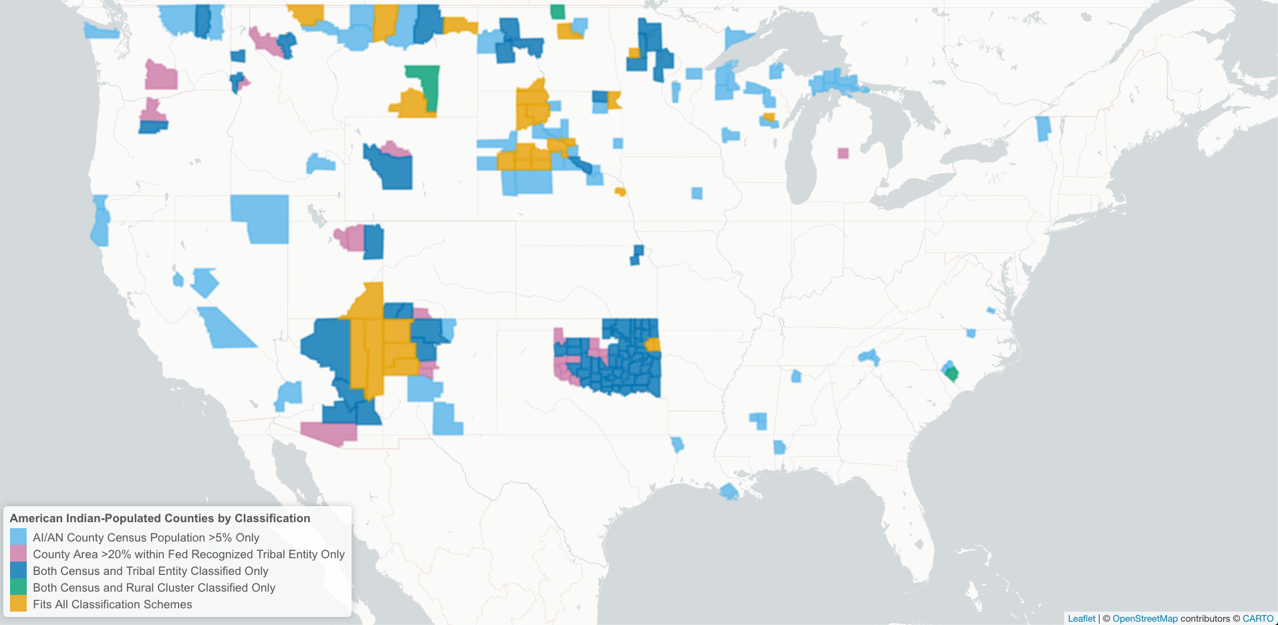
Notes:
Color blind friendly map

Slide 30
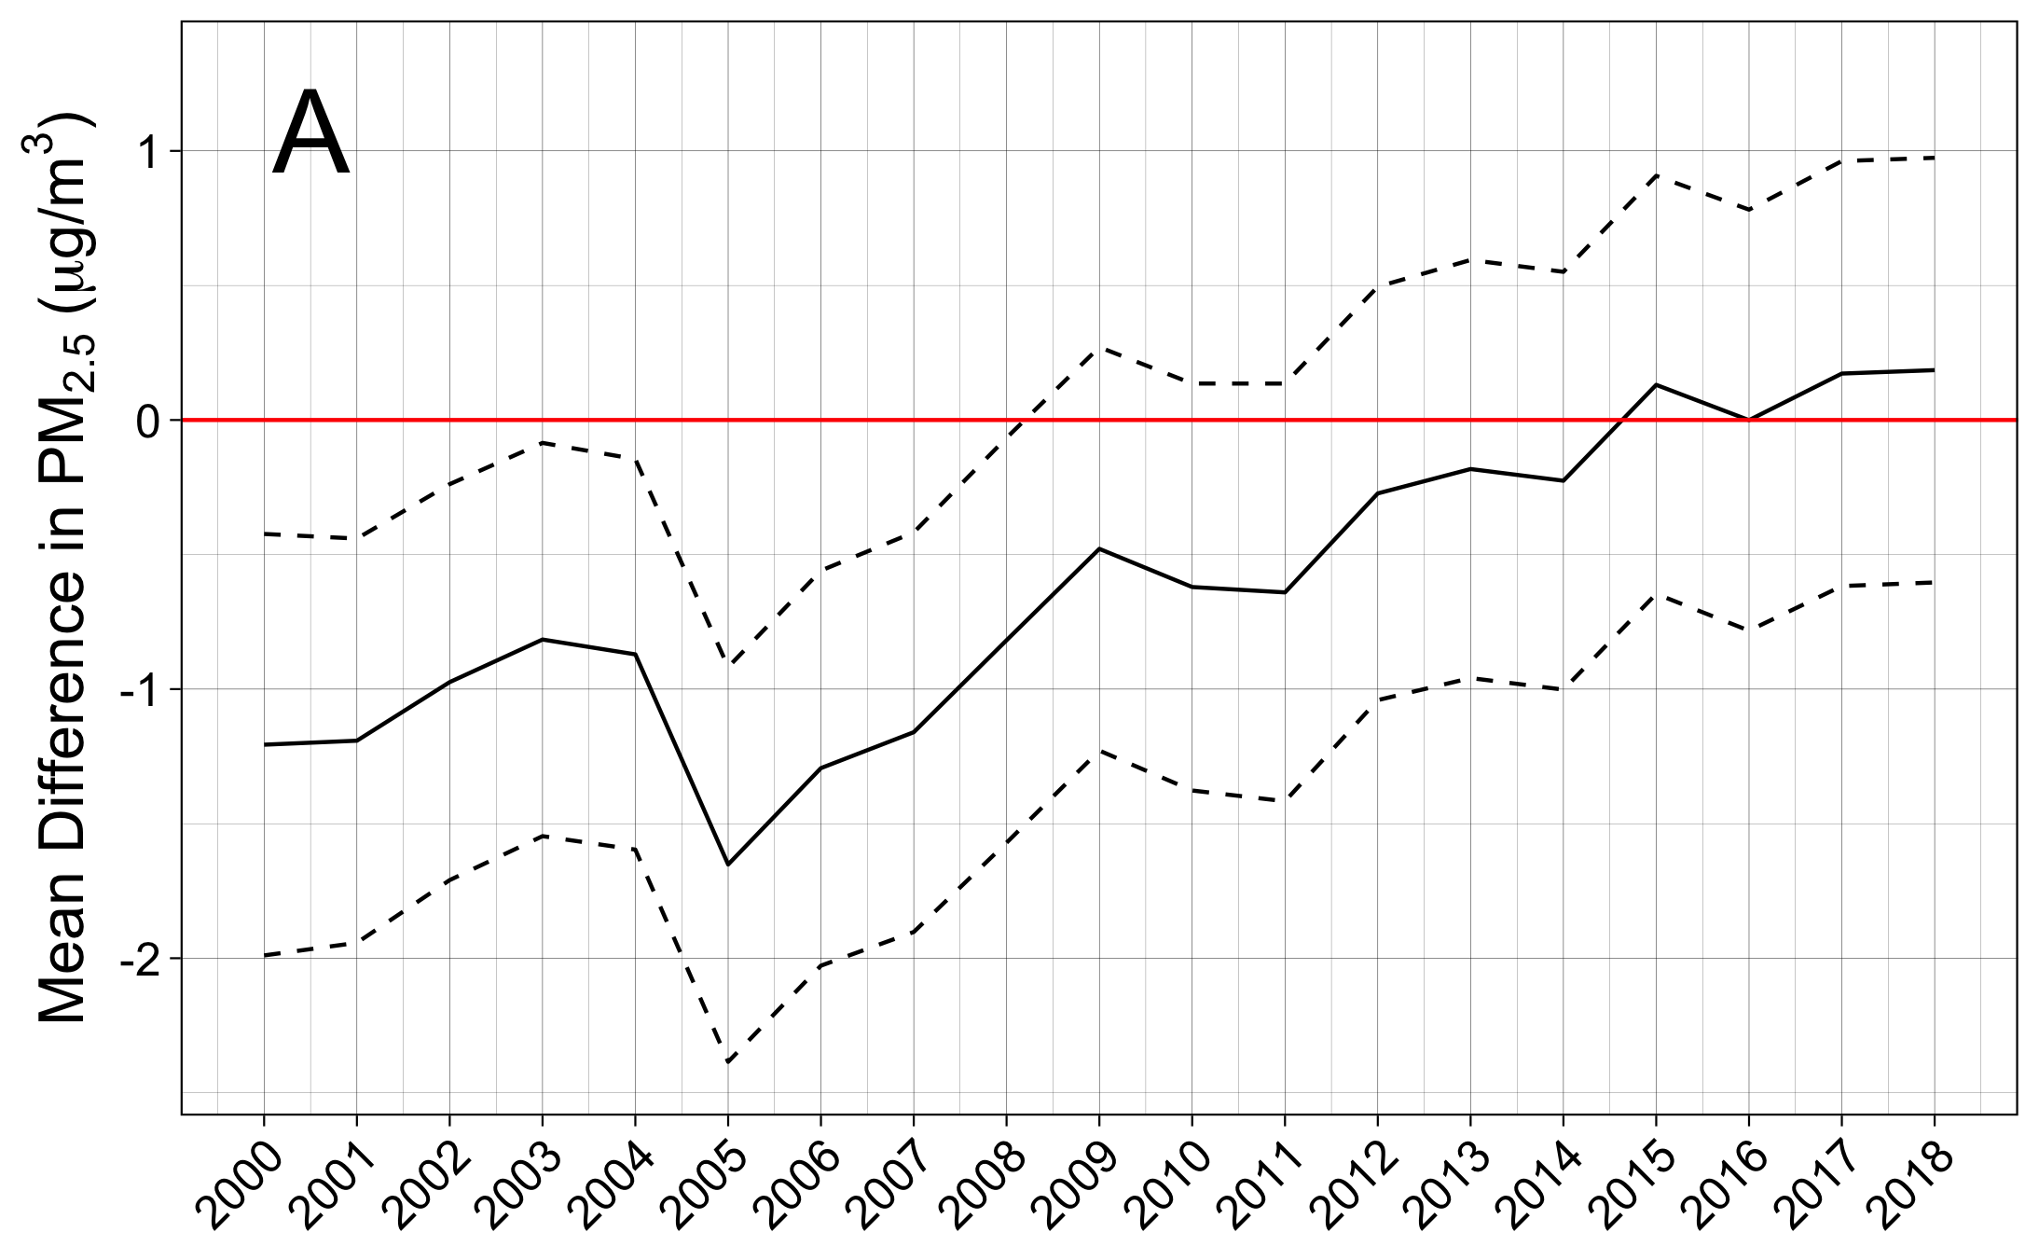
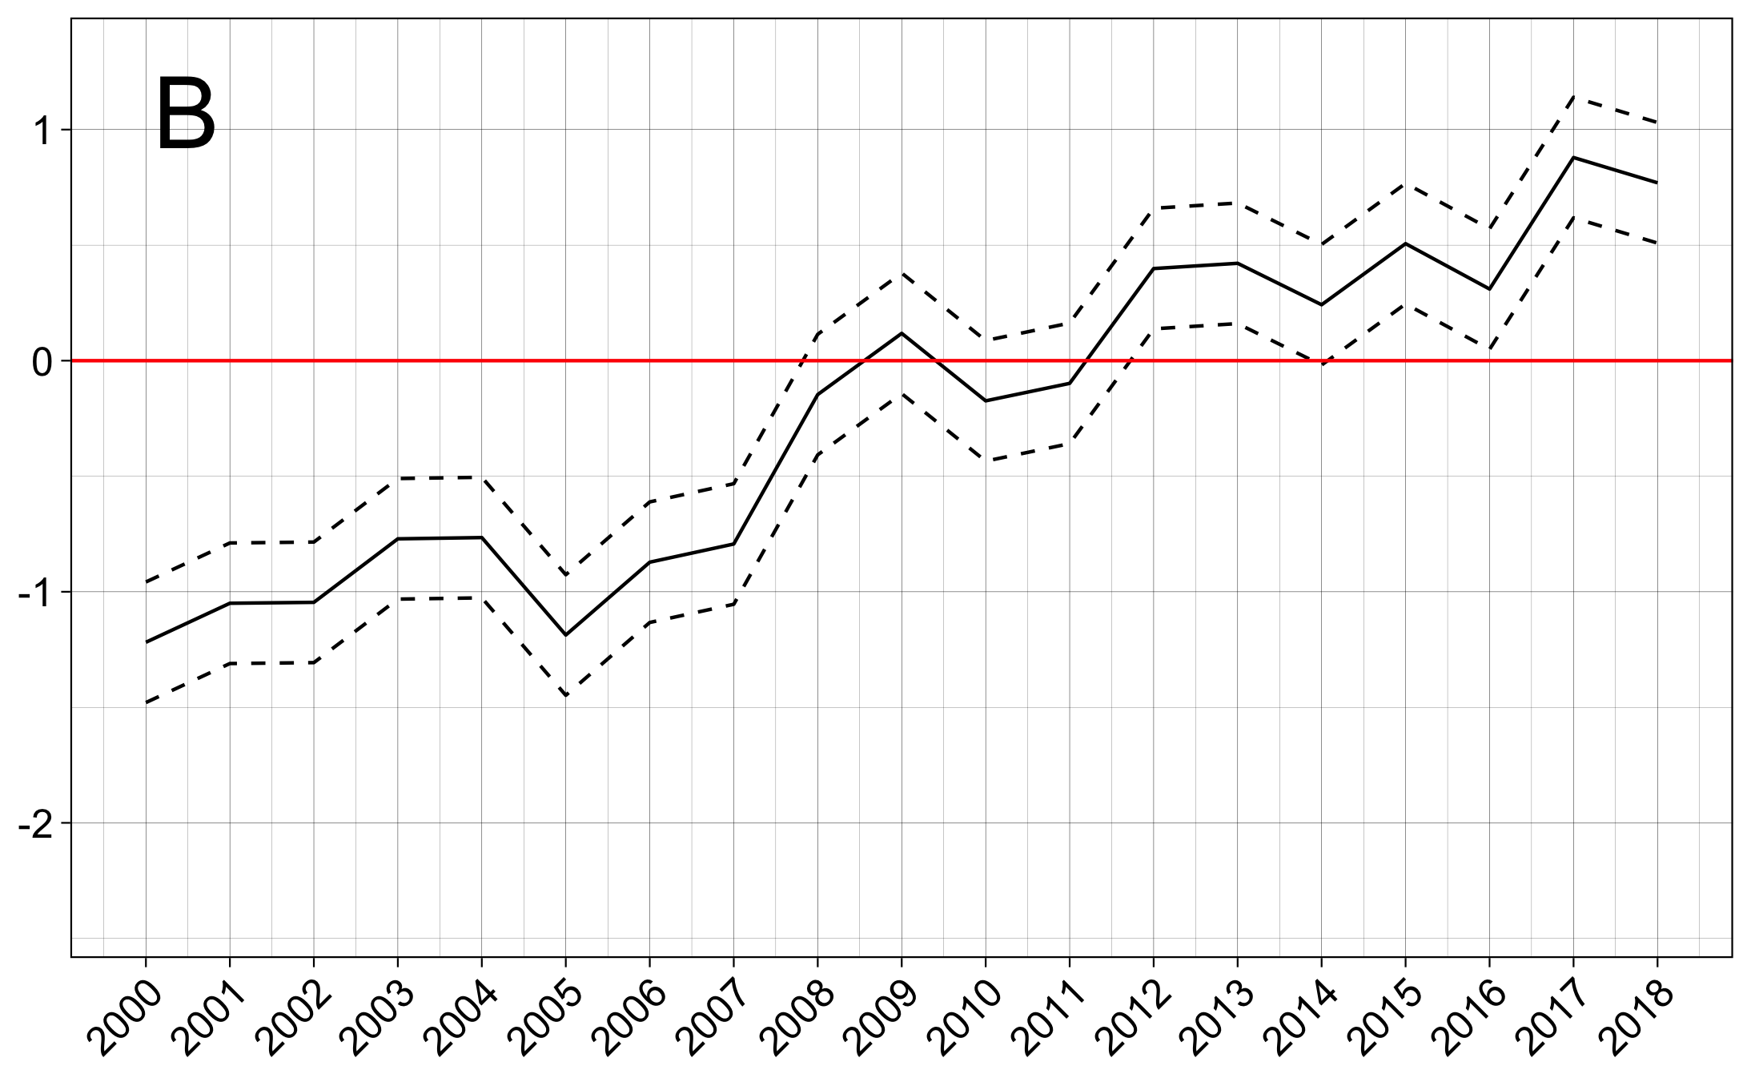
Notes:
Supplement interx plots (NCHS rural)

Slide 31
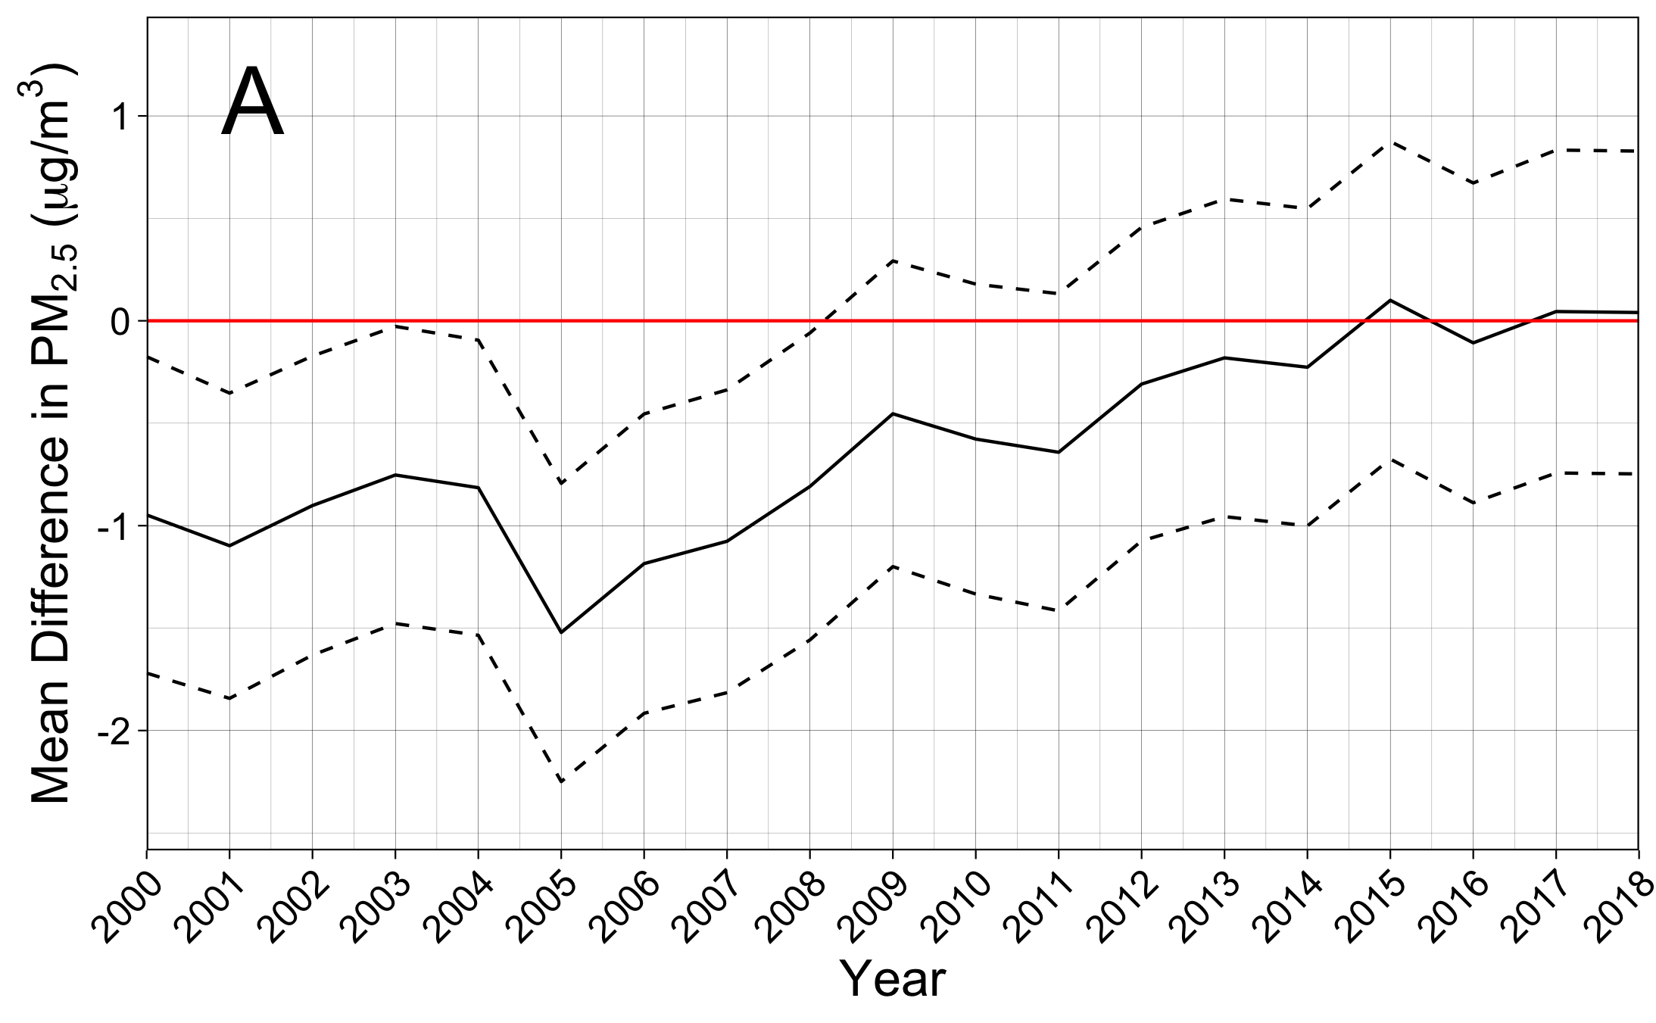
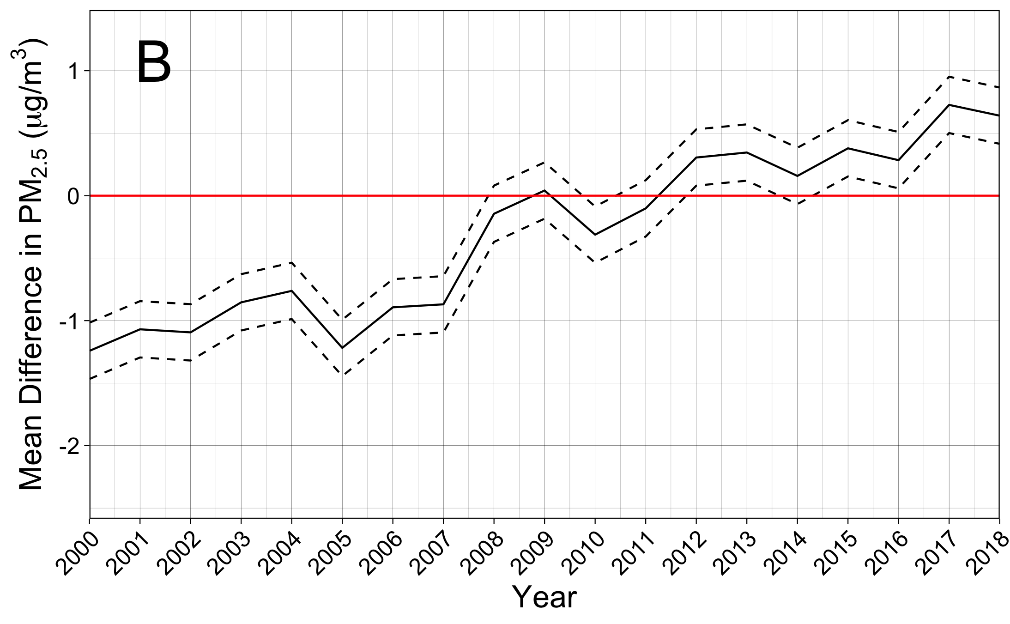
Notes:
Supplement interx plots (RUCA rural)

Slide 32
Notes:
Supplementary RUCA rural interX plots

Slide 33


Notes:
Model and monitor w/ interX

Slide 34


Notes:
NCHS Rural Model and monitor w/ interX

